Slide 1
Zinc Finger CONSTANS-Related and LOB-Domain Containing Genes
Nancy Phang
June 4, 2004

Slide 2
AT2G33350 (Gene One)
Chromosome 5
Gene # 33350
Length: 14141005 - 14144230 ~3225 bp
Orientation: 5’ - 3’ (Forward)
5’ UTR, 5 exons, 4 introns, 3’ UTR

Slide 3
Gene Structure
AT3G33340
AT3G33350
AT3G33360
3’
5’
5’
3’ 5’
3’
~2775 bp
~2643 bp
4936 bp
3226 bp
3321 bp
UTR
EXON 1
EXON 2
EXON 3
EXON 4
EXON 5
UTR
5’
187 bp
45 bp
INTRON
747 bp
201 bp
129 bp
105 bp
321 bp
3’
1201 bp
136 bp
76 bp
75 bp

Slide 4
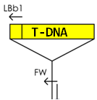
The T-DNA insert SALK_041681 is located from
14144131 to 14143694 bp and it is 437 bp long.
It lies in the 3’ to 5’ orientation
FW
RV
3’
95 bp
UTR

Slide 5
AT2G33350 Encoded Proteins
Encodes for a Zinc Finger CONSTANS-Related Protein 410 amino acids.
Zinc fingers proteins belong to a large superfamily of protein domains that can bind to DNA.
Without the zinc finger, a protein domain might unfold.

Slide 6
Microarray data indicates that this gene is active in all the above organs during seed development
RT-PCR is more sensitive than the microarray chip because in RT-PCR DNA is amplified so that the reaction is more sensitive to the presence of smaller DNA fragments.

Slide 7
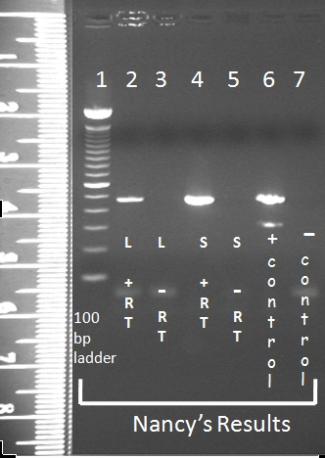
What do my RT-PCR Results Mean?
There were NO bands corresponding to the gene-specific primers in the +RT and –RT samples.
mRNA is not made in these organs during seed development

Slide 8
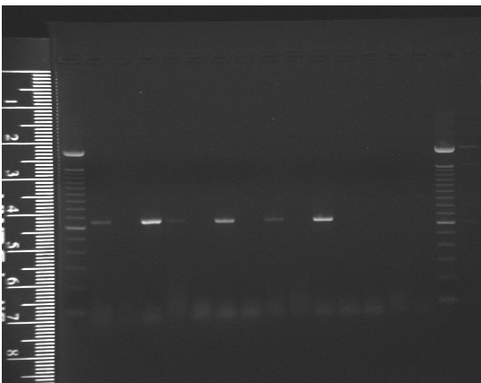
Genotyping AT2G33350
Expected Size of WT PCR band: 717 bp
Size of WT Gel Band: ~700
Expected Size of T-DNA PCR band: 649 bp
Size of T-DNA Gel Band: ~650
AT2G33350 Wild Type DNA Genotyping Gel
Plant #
neg control
1 2 3 4 5 6 7 9 81011
pos control
WT
1% agarose gel, 107 V, 50 minutes
Plants 1, 3, 4, 6, 8 and 10 are hemizygous
100 bp ladder
100 bp ladder
AT2G33350 T-DNA
pos control
neg control
1 2 3 4 5 6 7 8 9 10 11
1% agarose gel, 107 V, 50 minutes
pos control
Wild Type
Plants 2, 5, 7, 9, & 11 are homozygous wild-type
Hemizygous plants
Plants 1, 3, 4, 6, 8, & 10 are hemizygous T-DNA.
100 bp ladder
100 bp ladder

Slide 9
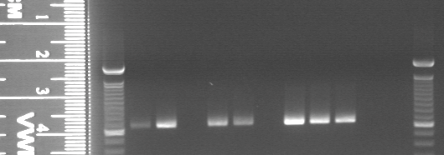
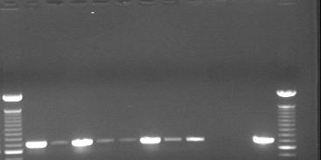
Genotyping AT2G33350
100 bp ladder
T-DNA
100 bp ladder
POS
WT
13 14 15 16 17 19 21 22 23
HOMOZYGOUS MUTANT
pos control
pos control
HEMIZYGOUS
100 bp ladder
WT
100 bp ladder
POS
WT
13 14 15 16 17 19 21 22 23

Slide 10
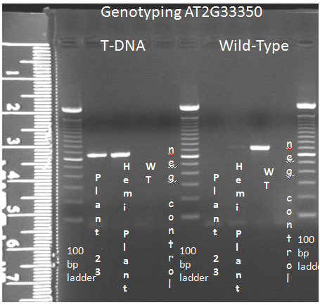
Genotyping AT2G33350
After a screening of 9 addition plants (total of 20), ONE homozygous T-DNA plant was found.
An additional 6 hemizygous and 2 WT plants were also found.

Slide 11
What do my results mean?
Genotype | # of Plants
Wild Type/Wild Type | 7
Hemizygous | 12
Mutant/Mutant | 1
Since I found a homozygous mutant, a knockout of AT2G33350 does NOT cause seed lethality!

Slide 12
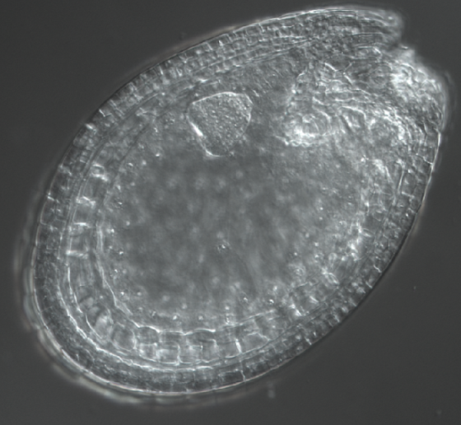
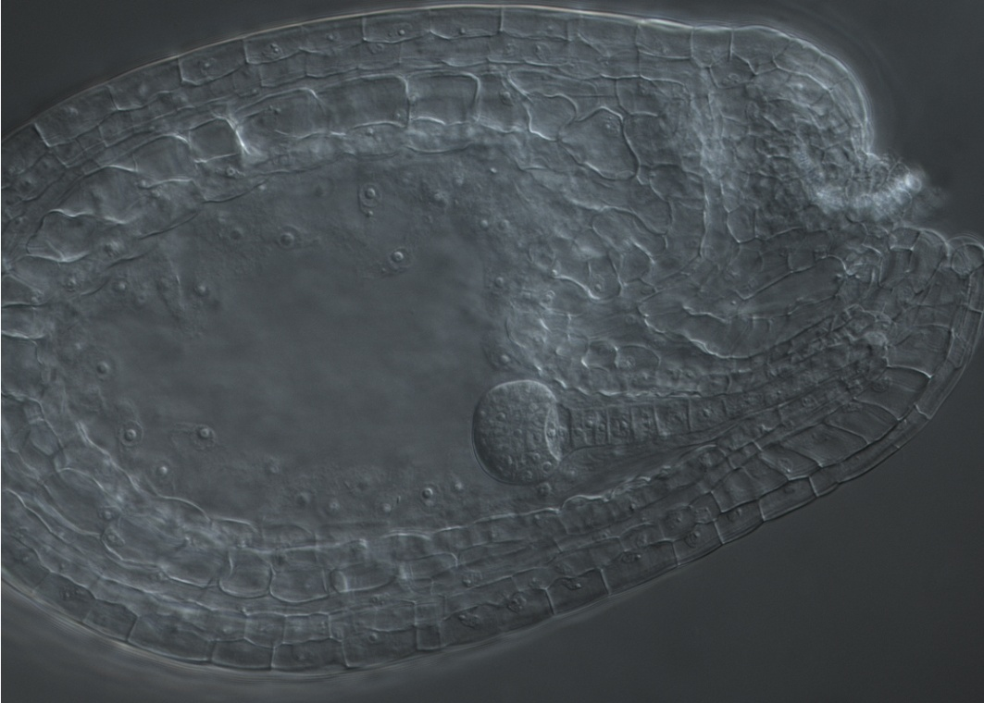
Nomarski of AT2G33350
There were no observed phenotypic differences between the hemizygous plants and the wild-type (WT) plants.
Seed coat
Seed coat
embryo
suspensor
suspensor
embryo
WT
Heart stage
Hemizygous
Globular Stage

Slide 13
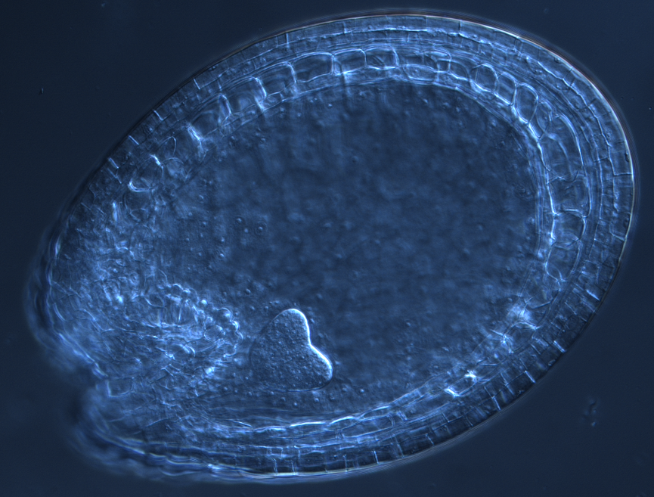
Were there any phenotypic differences during embryo and seed development?
Seed coat
Wild Type
embryo
suspensor
Homozygous T-DNA Seed (AT1G67100)
Seed coat
Nomarski microscopy of the heart & globular stage reveals no apparent phenotypic differences
embryo
suspensor

Slide 14
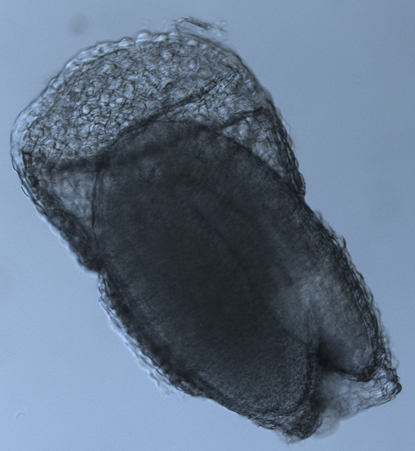
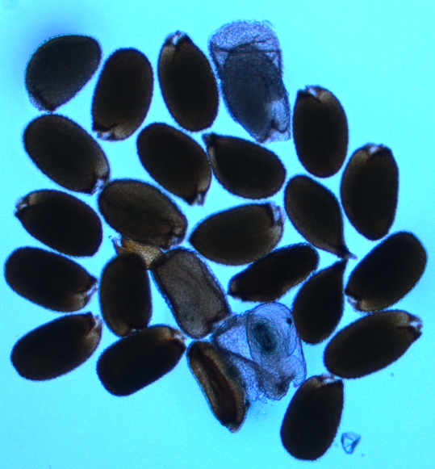
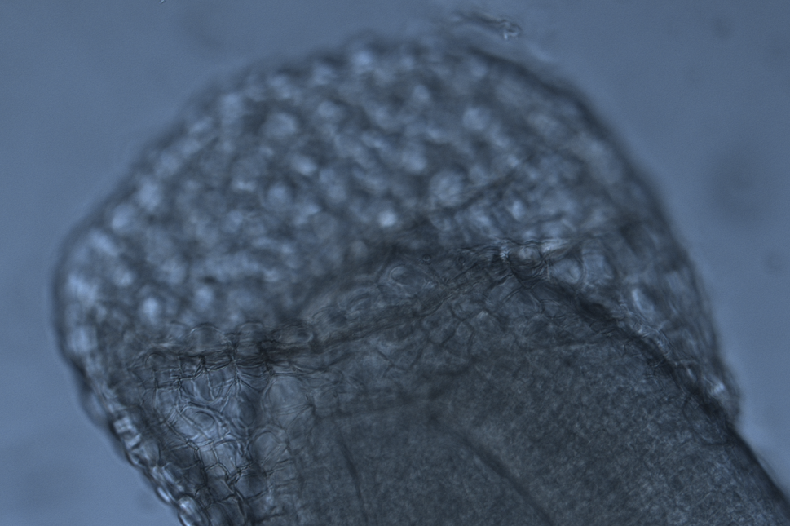
AT2G33350 Homozygous Mutant
There are approximately 25 seeds total. 23 appear to resemble wild-types. 2 appear to have seed coat mutations.

Slide 15
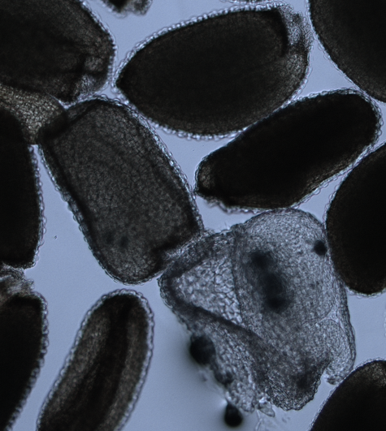
AT2G33350 Homozygous Mutant
There are approximately 25 seeds total. 23 appear to resemble wild-types. 2 appear to have seed coat mutations.
Because a knockout of this gene DOESN’T result in fatality, it is evident there are redundant domains that compensate for this knockout.

Slide 16
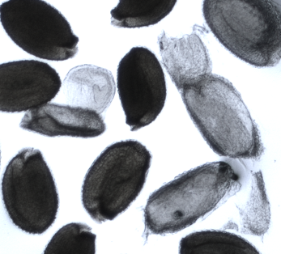
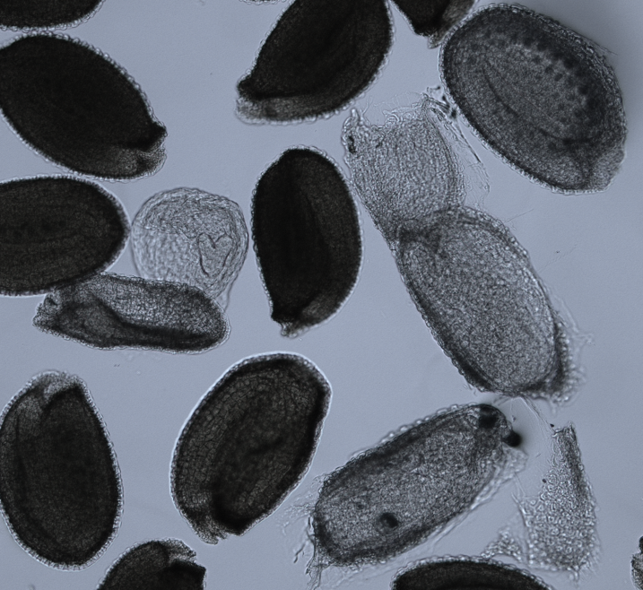
Upturned U
Heart Stage

Slide 17
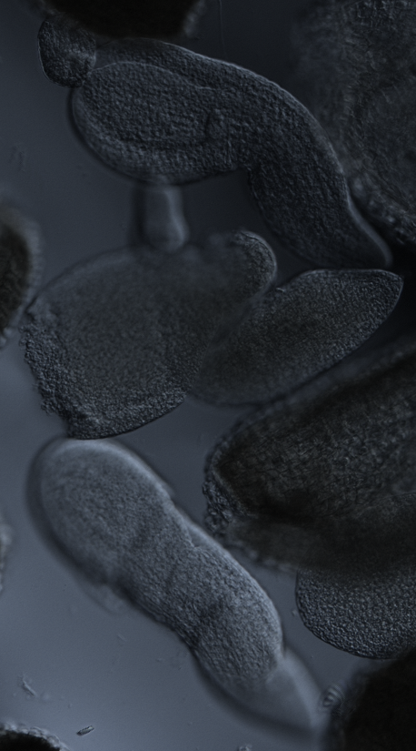
Torpedo Stage
Unknown Stage
Torpedo Stage

Slide 18
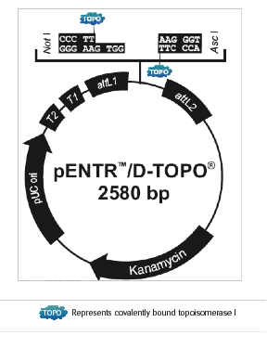
Cloning the Upstream Region of AT2G33350
The size of the pENTER/D-TOPO vector ~ 2.6 kb
The size of the insert is ~1.9 kb
The size of the vector with the insert should be ~4.5 kb

Slide 19
Confirming the Authenticity of Recombinant Plasmid DNA Via Restriction Enzyme Digestion
The bands at ~ 4.5 kb correspond to the plasmid with the insert.
The bands at ~ 2.6 correspond to the plasmid with no insert.
Plasmid with insert
Plasmid with no insert
1 kb ladder
1 kb ladder

Slide 20
AT1G67100 (Gene Two)
Chromosome 1
Gene # 67100
Length: 25057397 – 25058510 = 1113 bp
Orientation: 5’ - 3’ (Forward)
5’ UTR, 5 exons, 4 introns, 3’ UTR

Slide 21
Gene Structure
AT1G67090
AT1G67100
AT1G67105
3’
5’
5’
3’ 5’
3’
~2775 bp
~2643 bp
1267 bp
1113 bp
786 bp
3’

Slide 22
SALK_066633
Expected size of WT PCR product is 1049 bp
The T-DNA insert is located from 25058397 - 25057397 bpand it is 1000 bp long

Slide 23
In what tissues is AT1G67100 gene active?

Slide 24
Microarray
Gene chip data suggests that the gene should be active in seed coat, embryo proper, and endosperm of the seed.
It is active during the mature green, liner cotyledon, preglobular, and heart stages of plant development.

Slide 25
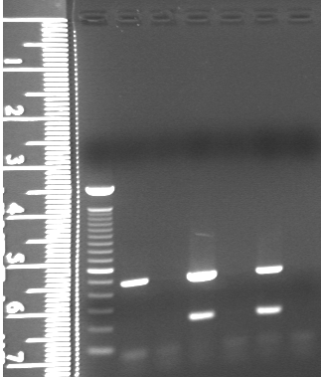
Analysis of AT1G67100 RT-PCR Results
There are no bands when there are no cDNA templates.
Check if the experimental band sizes agree with their expected sizes. In this case there is agreement.
100 bp ladder
S
ilique
+RT
S
ilique-RT
neg
control
Leaf
+RT
L
eaf-RT
gDNA
There is mRNA accumulation for the S+RT sample. AT1G67100 is expressed in the siliques
Tubulin
Bands
(500 base pairs)
mRNA accumulation bands
(205 base pairs)
1.5% agarose, 138 V, 37 minutes

Slide 26
What do my results mean?
Genotype | # of Plants
Wild Type/Wild Type | 6
Hemizygous | 3
Mutant/Mutant | 4
Since I found several homozygous mutant, a knockout of AT12G67100 does NOT cause seed lethality!

Slide 27
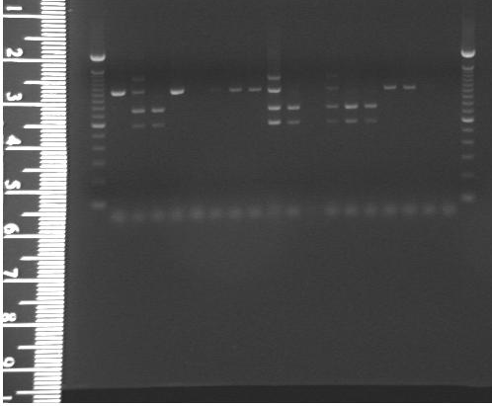
Genotyping AT1G67100
Expected Size of WT PCR band: 1049 bp
Size of WT Gel Band: ~1100
Plant #
1 2 3 4 5 6 7 8 9 10 11 12 13 14 15
Neg Control
Expected Size of T-DNA PCR band: 624 bp
Size of T-DNA Gel Band: ~610
WT
Col
0
Homo mutants: 3, 10, 13, 14
Hemi: 9,12
WT: 1, 4, 7, 8, 15,
100 bp ladder
100 bp ladder
Nancy’s Genotyping Results

Slide 28
Genotyping AT2G33350
Expected Size of WT PCR band: 717 bp
Size of WT Gel Band: ~700
Expected Size of T-DNA PCR band: 649 bp
Size of T-DNA Gel Band: ~650
AT2G33350 Wild Type DNA Genotyping Gel
Plant #
neg control
1 2 3 4 5 6 7 9 81011
pos control
WT
1% agarose gel, 107 V, 50 minutes
Plants 1, 3, 4, 6, 8 and 10 are hemizygous
100 bp ladder
100 bp ladder
AT2G33350 T-DNA
pos control
neg control
1 2 3 4 5 6 7 8 9 10 11
1% agarose gel, 107 V, 50 minutes
pos control
Wild Type
Plants 2, 5, 7, 9, & 11 are homozygous wild-type
Hemizygous plants
Plants 1, 3, 4, 6, 8, & 10 are hemizygous T-DNA.
100 bp ladder
100 bp ladder

Slide 29
AT1G67100 Encoded Proteins
AT1G67100 is a transcription factor gene active during seed development.
It codes for a LOB-containing protein (a lateral organ boundary protein) of 233 amino acids.
A LOB domain-containing protein is a DNA binding transcription factor that can interact with specific bHLH proteins.
It is active during the globular stage, cotyledon stage, and mature green embryo stage.

Slide 30
Were there any phenotypic differences during embryo and seed development?
Seed coat
Wild Type
embryo
suspensor
Homozygous T-DNA Seed (AT1G67100)
Seed coat
Nomarski microscopy of the heart & globular stage reveals no apparent phenotypic differences
embryo
suspensor

Slide 31
Acknowledgement
Thank you to everyone, students and faculties alike, of HC70AL Spring 2008
Special Thanks to:
Anhthu
Prof. Goldberg
Kristen
Daisy
Min
Brandon

