Slide 1
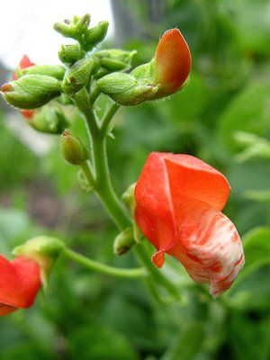
The Scarlet Runner Bean Genome: Contig 230613
By Eden Maloney

Slide 2
CONTIG 230613
Part of Scarlet Runner Bean (Phaseolus coccineus) Genome
18, 403 base pairs
Two Predicted Genes
Conserved Hypothetical Protein
Known from Soybean: Gylcine Max
2 possibly Repeats

Slide 3
FGENESH
FGENESH | Length of Genes (bp) | BLASTN | TBLASTN |  | BLASTP | Description
Gene 1 | 396 | 8e-73 | 6e-27 | 647 bp | 1.1 XP_001096185 | PREDICTED: microtubule associated monoxygenase, calponin and LIM domain containing 2 isoform 1 [Macaca mulatta]
Gene 2 | 273 | 6e-53 | 6e-13 | 161 bp | 5e-15 EEF27784 | conserved hypothetical protein [Ricinus communis]
Gene 3 | 273 | 5e-23 | 5e-18 | 742 bp | 2e-09 EEF27117 | conserved hypothetical protein [Ricinus communis]
Gene 4 | 630 | 0.0 | 2e-102 | 777 bp | 6e-115 CAA33227 | emb|CAA33227.1| unnamed protein product [Glycine max] 416 6e-115
Genescan
GeneMark

Slide 4
Genescan
GENESCAN | Length of Genes (bp) | BLASTN | TBLASTN |  | BLASTP | Description
Gene 1 | 48 | 2.3 | No significant Results |  | 9.3 EDK39880 | hypothetical protein PGUG_03978 [Pichia guilliermondii ATCC 6260]
Gene 2 | 990 | 7e-85 | 5e-58 | 647 bp | 1e-45 XP_002306324 | predicted protein [Populus trichocarpa]
Gene 3 | 489 | 8e-36 | 5e-23 | 742 bp | 1e-09 EEF27117 | conserved hypothetical protein [Ricinus communis]
Gene 4 | 489 | 1e-26 | 2e-08 | 853 bp | 1e-08 XP_002320937 | predicted protein [Populus trichocarpa]

Slide 5
GeneMark
GENEMARK | Length of Proteins (aa) | BLASTN | TBLASTN | BLASTP | Description
Gene 1 | 250 | NA | 5e-11 417 bp | 0.65 AAD28219 | cysteine aminopeptidase; PepC [Enterococcus faecium]
Gene 2 | 94 | NA | 2e -14 340bp | 0.001 ACB28472 | polyprotein [Ananas comosus]
Gene 3 | 85 | NA | 2e-08 473 bp | No Significant Results | N/A
Gene 4 | 305 | NA | 2e-26 647 bp | 4.3 YP_001323147 | lysyl-tRNA synthetase [Methanococcus vannielii SB]
Gene 5 | 113 | NA | 4e-13 161 bp | 5e-16 EEF27794 | conserved hypothetical protein [Ricinus communis]
Gene 6 | 197 | NA | 9e-23 742 bp | 2e-06 ABK28031 | unknown [Arabidopsis thaliana]
Gene 7 | 160 | NA | 7e-ll 555 bp | 7e-10 XP_002320939 | multidrug/pheromone exporter, MDR family, ABC transporter family [Populus trichocarpa]
Gene 8 | 170 | NA | 5e-12 661 bp | 2e-07 EEF27421 | conserved hypothetical protein [Ricinus communis]
Gene 9 | 231 | NA | 2e-18 663 bp | 2.4 YP_001434725 | hypothetical protein Igni_0134 [Ignicoccus hospitalis KIN4/I]
Gene 10 | 521 | NA | 9e-134 872 bp | 5e-148 CAA33227 | unnamed protein product [Glycine max]

Slide 6
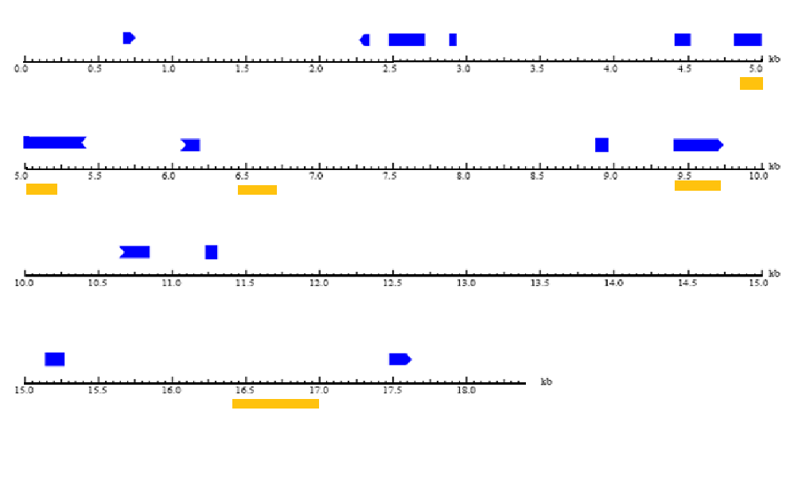
Diagram of Predicted Genes
Fgenesh
Genescan
GeneMark
Repeat

Slide 7
Overlapping Predicted Genes
Fgenesh
Genescan
GeneMark
Repeat

Slide 8
REPEATS?
Plant Repeat Database
Id | Description | E value
MRSiTETN00200002 | gi|13516330|emb|AJ309049.1|MTR309049 Medicago truncatula CACTA type transposable element, clone 70N13, sequence 2-1 | 194
GRSiTETNOOT00004 | gi|170080|nt4-3553 Soybean transposable element tgm1 | 165
MRSiTETN00200003 | gi|13516329|emb|AJ309048.1|MTR309048 Medicago truncatula CACTA type transposable element, clone 75I04 | 163

