Slide 1
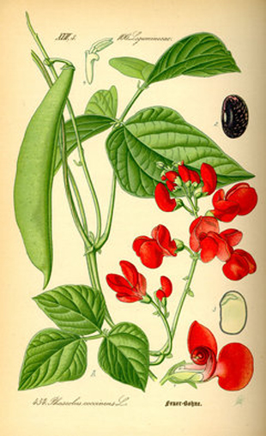
Scarlet Runner Bean Genome Sequence: Contig232576
By
Elaine Chiu

Slide 2
What is Contig232576?
A 15.1KB sequence in the SRB genome
Found 4 predicted genes that are supported by ESTs
1 predicted gene from Soybean
Contains 1 repetitive sequence: TY1/Copia about 240bp

Slide 3
How many predicted sequences are there and where are they located?
1 2
3
1 2 3 4 5 6 7 8 9 10 11
1 2 3 4
1 2 3 4
65
6047
0
11101
7384
15.1KB
1304
5381
11613
2473
4926
13451
14575
5216
29
2031
3041
6868
11760
6062
9549
1028
3373
6994
14138
2937
5752
10959
13005
120
9617
9976
14697
13192
1105
2064
FGENESH
GENSCAN
GENEMARK
BLASTn entire scaffold
Repeated sequence (n966-1306)

Slide 4
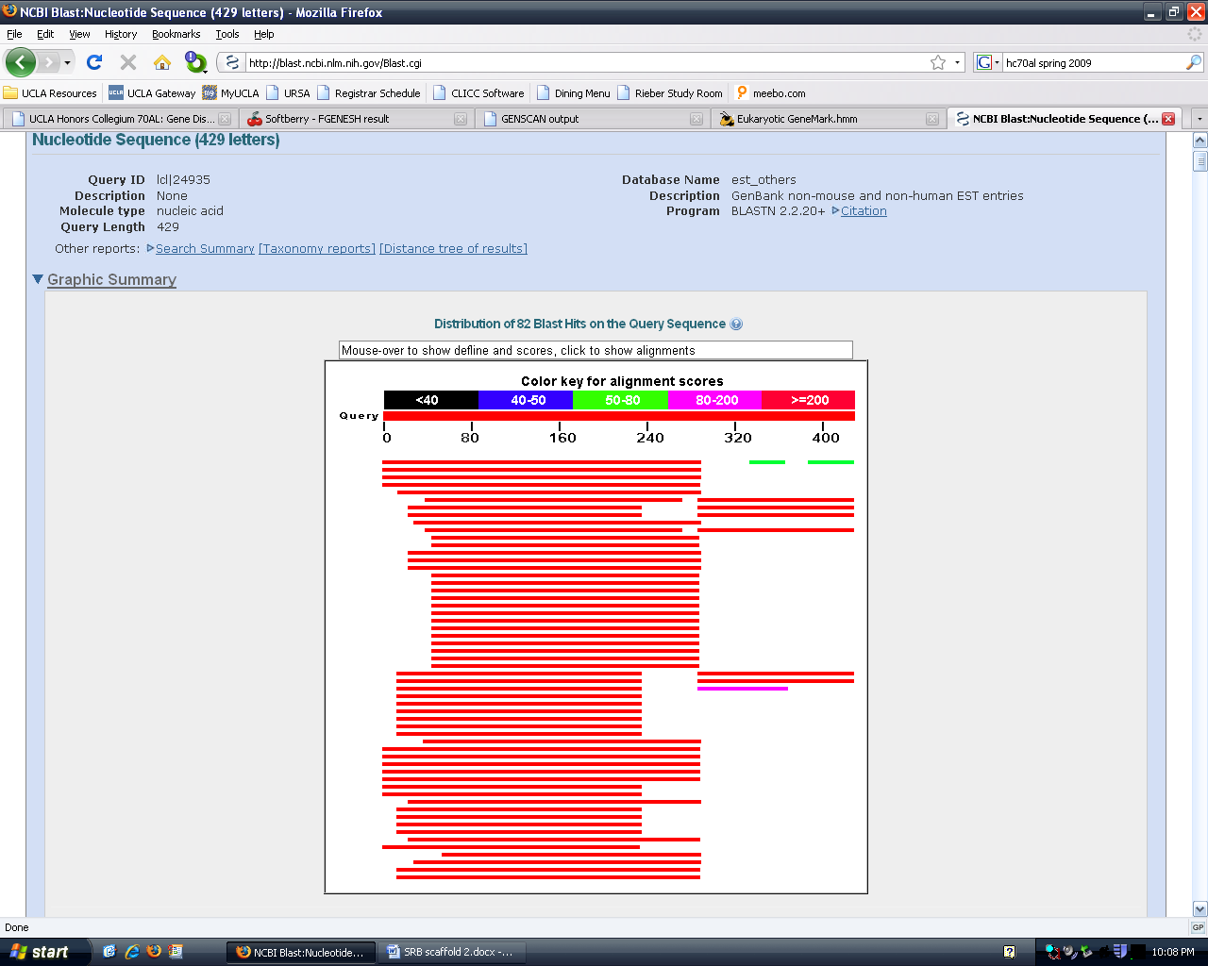
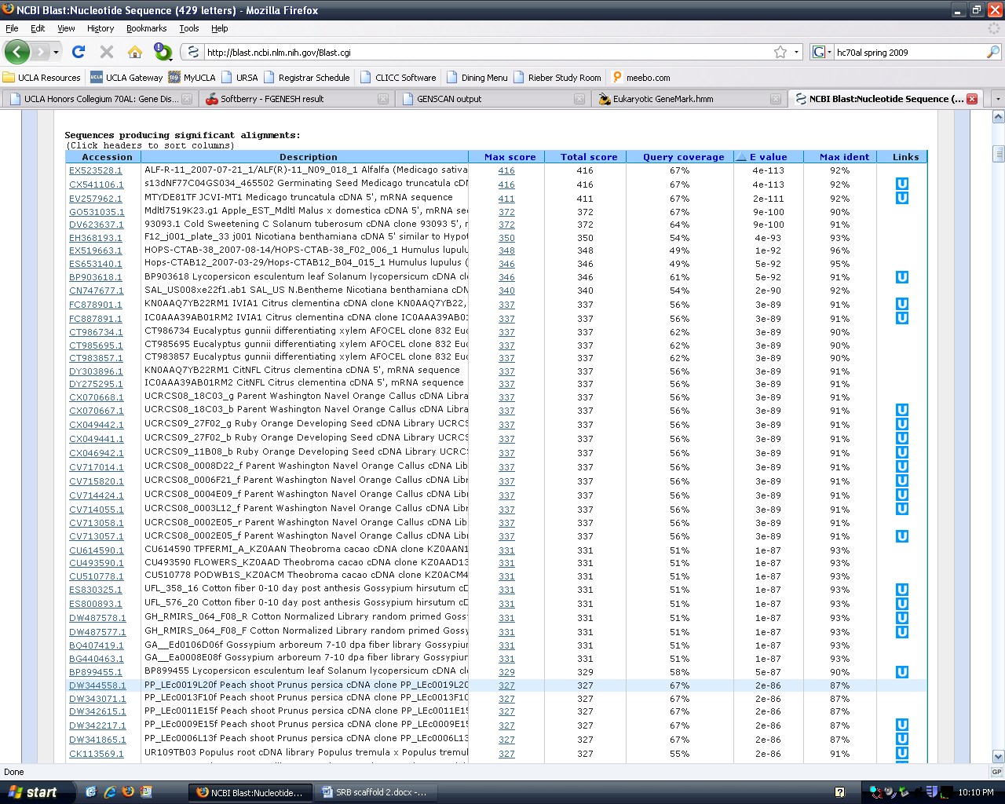
How do we determine if the predicted genes are likely to be real?
A predicted gene is
likely to be a real
gene if there are many
ESTs supporting it
If the E-value is very
Low, not likely to match
by chance (significance
cut-off is E-10)
ESTs
E-value of 4e-113

Slide 5
FGENESH | BLASTn | BLASTp | tBLASTn | Description
Gene 1 | n/a | 1.4 | 1.8 | Not significant (NS)
Gene 2 | 2e-44 | 5.5 | e-5 | 454PCS0275207 Scarlet Runner Bean globular stage suspensor
Gene 3 | 4e-113 | 5e-27 | e-30 | ALF-R-11_2007-07-21/ALF(R)-11_N09_018_1 Alfalfa (Medicago sativa) Trichome S13dNF77C04GS034_465502 Germiniating Seed Medicago truncatula
Gene 4 | 3e-65 | 1.7 | e-15 | VBL1_32_G04_E001.g1 Cotyledon and young leaves of peanut Arachis hypogaea
GENSCAN | BLASTn | BLASTp | tBLASTn | Description
Gene 1 | 3e-14 | 3.8 | n/a | CT986291 Eucalyptus gunnii
Gene 2 | 4e-6 | 4.4 | 0.57 | NS
Gene 3 | e-75 | 4e-24 | 6e-25 | KN0AAQ7YB22RM1 IVIA1 Citrus clementina ALF-R-11_2007-07-21/ALF(R)- 11_N09_018_1 Alfalfa (Medicago sativa) S13dNF77C04GS034_465502 Germiniating Seed Medicago truncatula
Gene 4 | n/a | 2.1 | n/a | NS

Slide 6
GENEMARK | BLASTn | BLASTp | tBLASTn | Description
Gene 1 | n/a | 1.4 | 5e-8 | NS
Gene 2 | n/a | e-26 | 2e-25 | ATP synthase CF1 beta subunit [Populus trichocarpa] VVB168G01_412143 An EST database for abiotic stressed leaves of Vitis vinifera
Gene 3 | n/a | n/a | n/a | n/a
Gene 4 | n/a | 1.4 | 1.8 | NS
Gene 5 | n/a | 0.46 | 5e-30 | IC0AA39AB01RM2 CitNFL Citrus clementina CT983857 Eucalyptus gunni
Gene 6 | n/a | 6e-26 | 4e-34 | S13dNF77C04GS034_465502 Germiniating Seed Medicago truncatula
Gene 7 | n/a | 0.67 | 4e-23 | 454GmaGlobSeed305299 Soybean Seeds Containing Globular Stage
Gene 8 | n/a | n/a | n/a | NS
Gene 9 | n/a | 3.0 | 2e-12 | VBL1_32_G04_E001.g1 Cotyledon and young leaves of peanut Arachis hypogaea
Gene 10 | n/a | 0.85 | e-20 | MOOE277TF MOO Vigna unguiculata
Gene 11 | n/a | 4.7 | 0.065 | NS

Slide 7
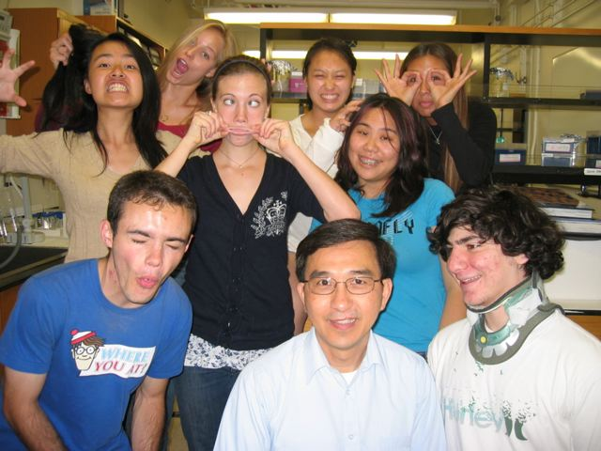
Thank You
Sorry Daisy, Kristin and Anhthu for spamming you.
LOL
Thanks Brandon, Min, Chen, Tomo,
Kelli for behind the scenes help.
So many photos to upload.
Thanks Ingrid for Monday night
dinners to everyone was always
late for.
Thanks Anhthu for making funny
jokes and for lunch. And teaching
me about Alaska.
Thanks Daisy and Kristin for
Always being in the lab when we
need you.
Thanks Dr. Goldberg for making this lab possible. I never imagined I could do something like this in my freshman year (and enjoy it).

