Slide 1
What Are the Methods and Approaches Used Study Knock-Out Mutations?
Elaine Chiu
Nancy Phang
June 4, 2009

Slide 2
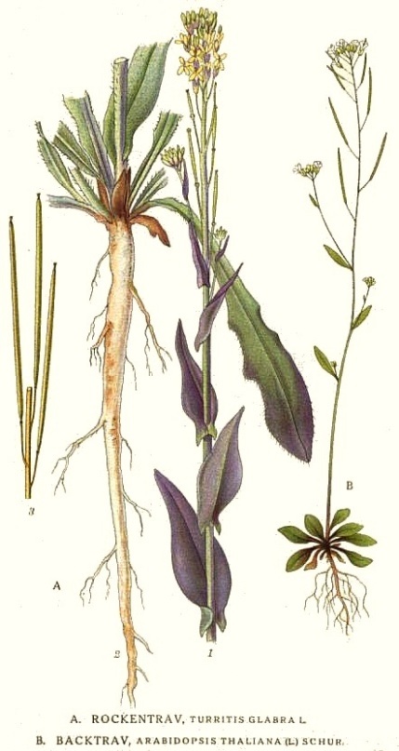
Isolation
Grow plants.
Collect leaves.
Isolate DNA from the leaves.

Slide 3
How do we screen for
T-DNA inserts?
5’
3’
T T A T
RV
5’
3’
3’
A A T A
A C T G
5’
FW
3’
T G A C
5’
PCR!!

Slide 4
How does this apply to the screening for
T-DNA inserts?
LBb1
5 kb T-DNA Insert
5’
3’
T T A T
RV
5’
3’
3’
A A T A
A C T G
5’
FW
3’
T G A C
5’
Use TAIR to determine
insertion site of T-DNA
T-DNA genotype based of Forward and LBb1 Primer Interaction

Slide 5
T-DNA genotype based on Reverse and LBb1 Primer Interaction
5’
3’
T T A T
RV
5’
3’
3’
A A T A
A C T G
5’
FW
3’
T G A C
5’
LBb1

Slide 6
Multiplex vs. Separate Reactions
Multiplex
Water
10x Ex Taq Buffer
dNTP Mix
Fw Primer
Rv Primer
LBb1 Primer
Ex-Taq DNA Polymerase
Separate
Water | Water
10x Ex Taq Buffer | 10x Ex Taq Buffer
dNTP Mix | dNTP Mix
Fw Primer | Add Fw or Rv Primer depending on direction of LBb1 primer
Rv Primer
 | LBb1 Primer
Ex-Taq DNA Polymerase | Ex-Taq DNA Polymerase

Slide 7
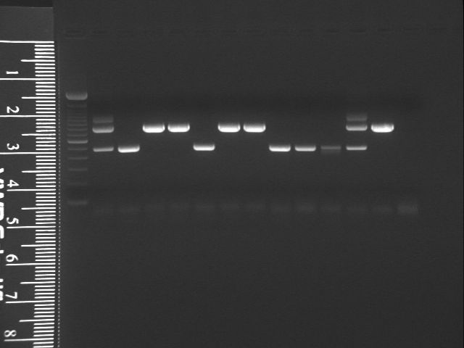
Gel Photo of
Multiplex Reaction
Hemizygous
Homo T-DNA

Slide 8
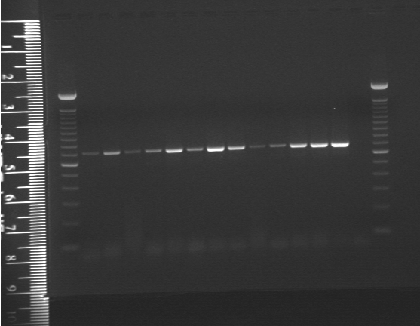
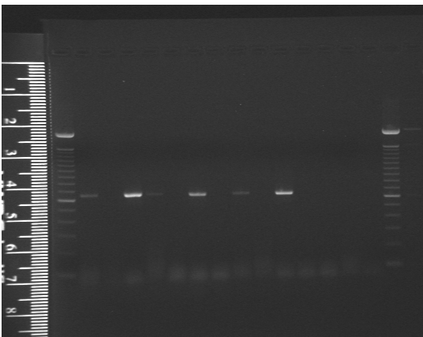
Gel Photos of Separate Reactions
AT2G33350 Wild Type DNA Genotyping Gel
Plant #
1 2 3 4 5 6 7 9 81011
Wild Type
pos control
neg control
1% agarose gel, 107 V, 50 minutes
Plants 1, 3, 4, 6, 8 and 10 are hemizygous
100 bp ladder
100 bp ladder
AT2G33350 T-DNA
1% agarose gel, 107 V, 50 minutes
1 2 3 4 5 6 7 8 9 10 11
Wild Type
neg control
pos control
Plants 2, 5, 7, 9, & 11 are homozygous wild-type
Hemizygous plants
Plants 1, 3, 4, 5, 6, 7, 8, & 10 are hemizygous T-DNA.
100 bp ladder
100 bp ladder

Slide 9
Gel Electrophoresis
Excess primers might leave faint “primer dimers” bands at the ends of the gel
Ethidium Bromide (EtBr) is used to help visualize the gel fragments. It binds to the DNA and fluoresces brightly under UV light.
A higher % agarose gel is used when better separation of small fragments is needed. A higher % gel causes the fragments to move more slowly but larger fragments won’t separate as well.

Slide 10
How Do We Determine Whether the T-DNA Insert is in the Correct Location and Orientation?
If no homozygous T-DNA plants:
1. Excise band from gel
2. Purify the band
3. Sequencing Reaction
If have homozygous t-DNA plants:
1. T-DNA fragment can be purified directly from PCR products
2. Sequencing Reaction

Slide 11
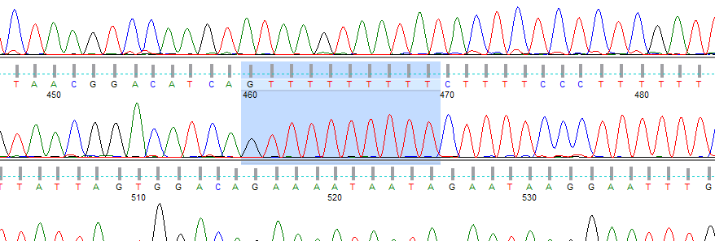
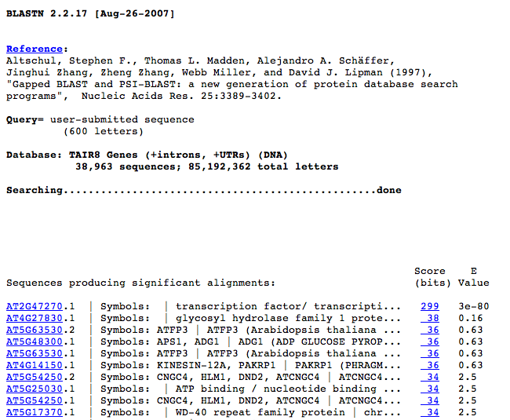
What do we do with the sequencing results?
Finch TV processes sequencing results.
BLAST obtained sequence to find out if it corresponds to the gene of interest.

Slide 12
The Use of RT-PCR to Study Gene Expression
mRNA is only present in cells for genes that have been transcribed
RT-PCR links gene expression to mRNA accumulation
Reagents used in PCR are DNA specific so mRNA cDNA by reverse transcriptase.
If PCR products form with the gene-specific primers for RT-PCR, the correlating cDNA of the original mRNA gene has been amplified
  Indicates presence of mRNA correlating to gene of interest

Slide 13
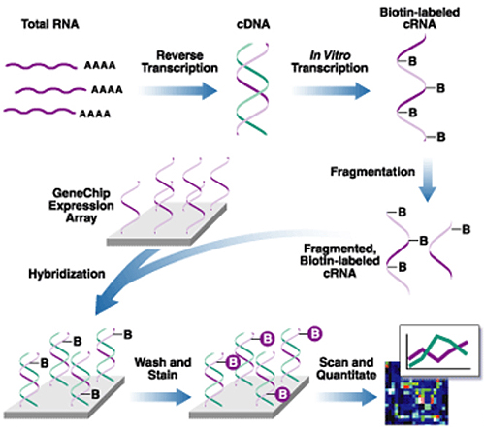
The Use of Microarrays to Study Gene Expression
Create cDNA from the mRNA isolated from various organs.
Each chip’s well contains the complementary strands of a different gene.
Different chips are used for various stages of development
cDNA sequences are tagged with fluorescent labels that glow a certain color when in contact with the complementary strand; this colors are analyzed by a computer

Slide 14
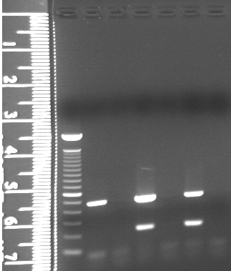
Analysis of AT1G67100 RT-PCR Results
There are no bands when there are no cDNA templates.
Check if the experimental band sizes agree with their expected sizes. In this case there is agreement.
100 bp ladder
S
ilique
+RT
S
ilique-RT
neg
control
Leaf
+RT
L
eaf-RT
gDNA
There is mRNA accumulation for the S+RT sample. AT1G67100 is expressed in the siliques
Tubulin
Bands
(500 base pairs)
mRNA accumulation bands
(205 base pairs)
1.5% agarose, 138 V, 37 minutes

Slide 15
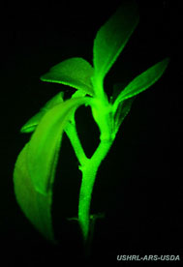
How Do We Know if a Gene is Expressed?
Technique: Insert the promoter region of a gene into the promoter of another vector containing GUS (produce blue color when gene is expressed) and GFP (glows green under UV light when gene is expressed). Then transform a plant with this vector using Agrobacterium and examine its offspring for any blue color or glowing feature.

Slide 16
Light Microscopy and Nomarski Microscopy
Observe phenotypical differences between wild type and homozygous mutants, if there are none, study seeds from hemizygous plants
Study seeds with a light microscope
Use Nomarski microscopy to observe seed embryos.

Slide 17
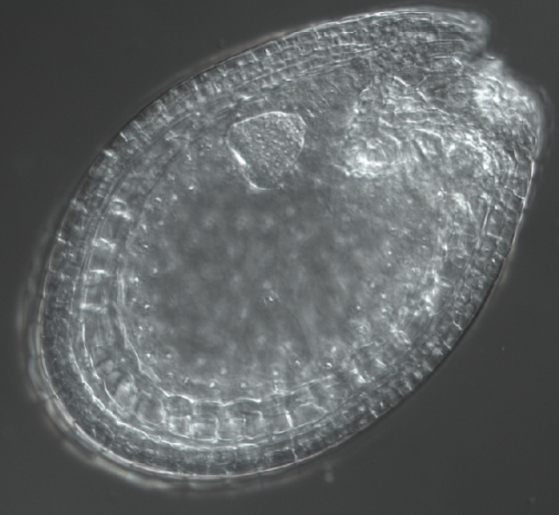
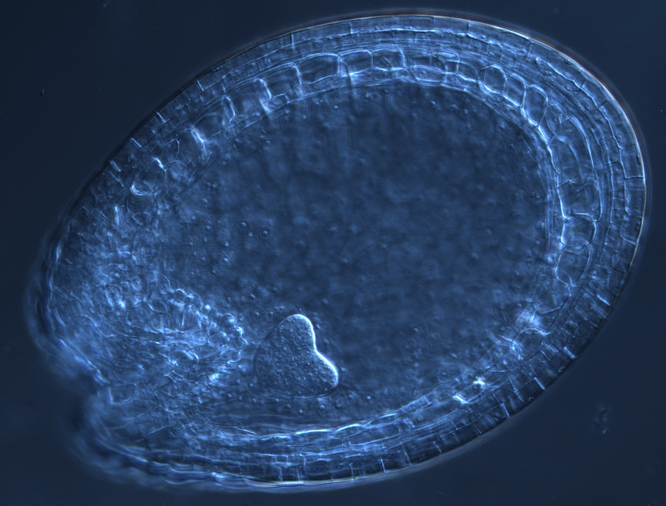
Were there any phenotypic differences during embryo and seed development?
Seed coat
Wild Type
embryo
suspensor
Homozygous T-DNA Seed (AT1G67100)
Seed coat
Nomarski microscopy of the heart stage reveals no apparent phenotypic differences
embryo
suspensor

