Slide 1
CAAT-Box
Elaine Chiu
Eden Maloney
Nancy Phang

Slide 2
Transcription
Transcription: DNA mRNA protein
Transcription factors are sequence-specific DNA binding factors proteins. They promote or block transcription by controlling the recruitment of RNA polymerase
Transcription is initiated at regions of DNA called promoters.
Specific sequences of nucleotide bases at a promoter are recognized by both transcription factors and RNA polymerase, the enzyme that synthesizes RNA.
The mRNA strand produced is complementary to the transcribed strand (the antisense strand) and has the sequence of the of the sense strand with T U.

Slide 3
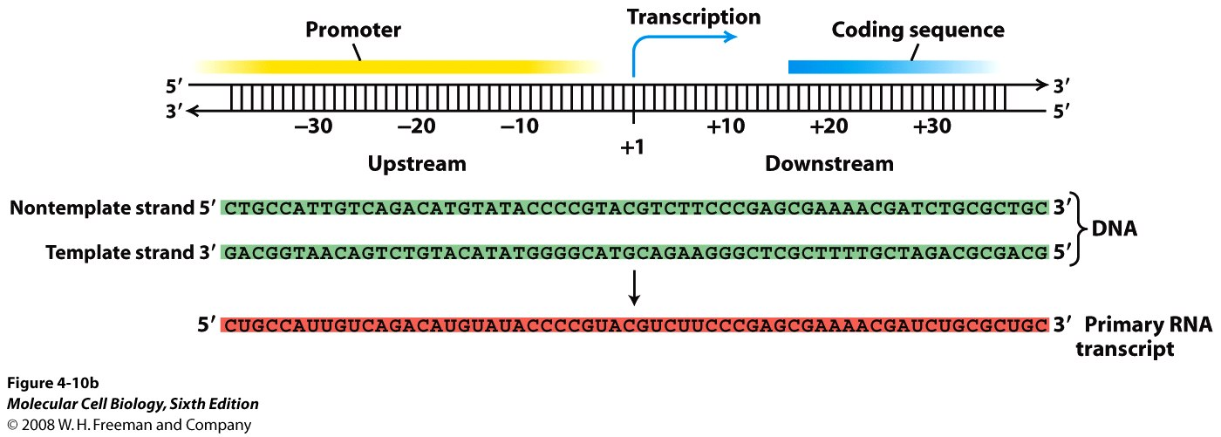
A Conceptualized Gene
Beginning
End
Sense Strand
Transcribed Strand

Slide 4
What is Contained in the Promoter?
Promoter
5’
3’
CAAT box
TATA box
Gene
-80
-30
1
2000
Start site of gene
Eukaryotic promoter regulatory sequences typically bind proteins called transcription factors, which are involved in the formation of the transcriptional complex

Slide 5
What is a CAAT Box and What Does it Do?
CAAT Box or CCAAT box is a conserved (shared) sequence in the promoter region of a gene in Eukaryotic Genomes.
Signals the binding site for the RNA transcription factor
Regulation of transcription

Slide 6
Consensus Sequence
It is a conserved nucleotide sequence repeated several times in the genome, with different roles for different locations.
recognition sites for many biological processes.
Examples: Consensus sequences can be found in transcription factor sites, restriction sites, transposon insertion sites, and splice sites.

Slide 7
What is the TATA box?
The TATA box is found in promoter region of most genes in eukaryotes
Sequence: TATAAT
Considered to be the core promoter sequence
The binding site of either transcription factors or histones
- Binding site of RNA polymerase II

Slide 8
What Genes Have a CAAT Box?
Genes that need to be transcribed in large amounts.
Often absent from genes that are transcribed in almost all cells.
For example, Tubulin
A protein that makes up the microtubules which is the foundation for the cytoskeleton of the cytoplasm and is found in virtually all plant cells
Used as a positive control in RT-PCR

Slide 9
What binds to CAAT?
The CCAAT box is one of the most wide spread promoter elements, being present in 25% of eukaryotic promoters
to date, the one protein that binds and activates the CCAAT box is nuclear factor Y (NF-Y), a trimer composed of distinct subunits: NF-YA, NF-YB and NF-YC.
NF-YB-NF-YC belong to the class of histone fold motif (HFM) proteins
http://www.sciencedirect.com/science?_ob=ArticleURL&_udi=B6T39-450HH59-1&_user=4423&_rdoc=1&_fmt=&_orig=search&_sort=d&view=c&_acct=C000059605&_version=1&_urlVersion=0&_userid=4423&md5=967cc14b8a746cf9bfe626d967ccdf93

Slide 10
EXPERIMENT ONE
“Even though a "CCAAT" box element is localized approximately equal to 80 base pairs upstream of the transcription initiation site in many eukaryotic promoters, it is not recognized by a single ubiquitous transcription factor.”
For example, a transcription factor that binds to the CCAAT box of a protein’s gene specific to the liver was also found in the spleen.
http://www.pubmedcentral.nih.gov/articlerender.fcgi?artid=279634

