Slide 1
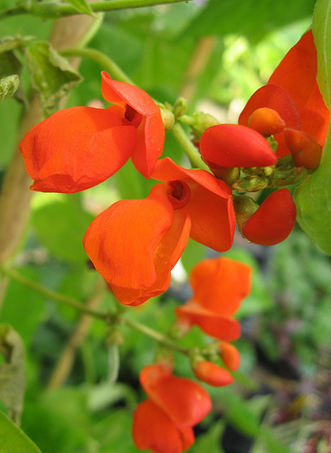
Scarlet Runner Bean Genome Assembly
Nancy Phang
June 4, 2004

Slide 2
Contig266405 is 23.3 kb
FGENESH | BLASTn | BLASTp | tBLASTn | Description
Gene 1 | 6e-17 | 2.9 | 3e-38 | P063968 Lotus japonicus mature nodule Lotus japonicus cDNA cloneGENLf031c12 3', mRNA sequence. Carica papaya mitochondrion, complete genome
Gene 2 | 2e-157 | 9e-39 | 7e-66 | 2369 Tepary bean root cDNA Phaseolus acutifolius cDNA clone LR0990,mRNA sequence. Os12g0525300 [Oryza sativa (japonica cultivar-group)] Cinnamodendron ekmanii small subunit ribosomal RNA gene, partialsequence; mitochondrial
Gene 3 | 3e-09 | NS | NS | NS

Slide 3
GENSCAN | BLASTn | BLASTp | tBLASTn | Description
Gene 1 | 2e-08 | 4.9 | 3e-46 | Carica papaya mitochondrion, complete genome
Gene 2 | 0.0 | 1e-34 | 2e-76 | JGI_ACBU3381.fwd ACBU Phakopsora pachyrhizi infected soybeanleaf tissue 6-8 days post inoculation with TW72-1 urediniosporesGlycine max cDNA clone ACBU3381 5', mRNA sequence. hypothetical protein [Vitis vinifera] Medicago truncatula clone mth2-7h6, complete sequence

Slide 4
GENEMARK | BLASTn | BLASTp | tBLASTn | Description
Gene 1 | n/a | 3e-32 | 3e-32 | Phaseolus vulgaris clone cosmid 9D10 tRNA-Tyr and tRNA-Asn genes,complete sequence; mitochondrial Phaseolus vulgaris clone cosmid 9D10 tRNA-Tyr and tRNA-Asn genes,complete sequence; mitochondrial
Gene 2 | n/a | 5.1 | 9e-65 | Phaseolus vulgaris clone cosmid 9D10 tRNA-Tyr and tRNA-Asn genes,complete sequence; mitochondrial
Gene 3 | n/a | 0.96 | 2.9 | NS
Gene 4 | n/a | 5e-09 | 2e-08 | Vitis vinifera contig VV78X237318.5, whole genome shotgun sequence
Gene 5 | n/a | 4.7 | 2e-21 | Medicago truncatula clone mth2-7h6, complete sequence
Gene 6 | n/a | 5e-26 | 5e-111 | hypothetical protein ZeamMp158 [Zea mays subsp. mays] Soybean 18S ribosomal RNA gene
Gene 7 | n/a | 4e-13 | 1e-34 | unnamed protein product [Vitis vinifera] Medicago truncatula clone mth2-7h6, complete sequence
Gene 8 | n/a | 2e-44 | 4e-53 | hypothetical protein [Vitis vinifera] Lotus japonicus genomic DNA, chromosome 5, clone: LjT25M07, TM1837,complete sequence
Gene 9 | n/a | 2.5 | 1e-36 | Glycine max strain Williams 82 clone GM_WBb0027P13, completesequence
Gene 10 | n/a | 6.8 | 6e-16 | Bambusa oldhamii mitochondrion, complete genome
Gene 11 | n/a | 1.1 | 4.8 | NS
Gene 12 | n/a | 4.8 | 9.7 | NS

Slide 5
SRB 23.3 kb Contig266405
Genscan
FGENESH
GENEMARK
Repeat

Slide 6
SRB 23.3 kb Contig266405 Overlaps
Overlap
ß
Genscan
FGENESH
GENEMARK
Repeat

Slide 7
Plant Repeats Database
There were 2 Small RNA gene repeats
They were a total of 349 bp in length
Covered 1.49% of sequence
Repeat 1 is located from: 14112- 13550 bp.
Repeat 2 is located from: 14663 – 14871 bp.
Repeats 3 and 4 are located from: 14202-14229bp and 14908-15142 and 13592-13922 bp.
RepeatMasker Results
There were 2 Small RNA gene repeats
They were a total of 349 bp in length
Covered 1.49% of sequence
Repeat 1 is located from 14202- 14429 bp and 15067-15142. Repeat 2 is located from 15265-15309 bp.

