Slide 1
Seed Development in Arabidopsis thaliana
Chris McQuilkin and Eden Maloney

Slide 2
The Importance of Seeds
With population growing, crops are going to become more scarce.
We will need to produce more food in the next 50 years than in the whole of human history
Solution: INCREASE YIELD amount of crops you can make in a given amount of land
DEVELOPMENTAL AND STRESS
Herbicide and pesticide resistance, drought resistance, larger produce, and etc.

Slide 3
Why is Arabidopsis Our Model Organism?
Related to red and green cabbages, which are popular crops
Thus discoveries about Arabidopsis can be applied to cabbage and other important crops.
Also easy to grow because it has only a three month generation time.
This is useful because this means we can obtain mutants and knockout lines quickly

Slide 4
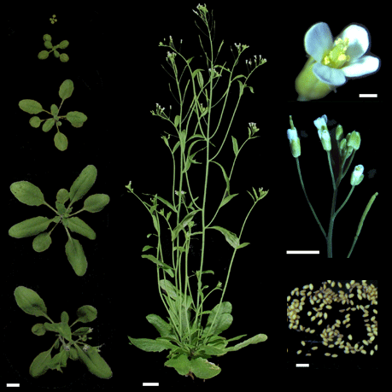
What are Other Unique Characteristics?
It is also a small plant
Easy to manage
Has a small genome
Tightly packed genes
Genome is Sequenced!
This is useful because
Lower Plant Growth Center costs
With tightly packed genes
We don’t need to sort through as many Intron
With a sequenced genome we can
Easily create primers
This allows us to amplify specific genes of interest
We can double check recombinant experiments
5 prime to 3 prime direction

Slide 5
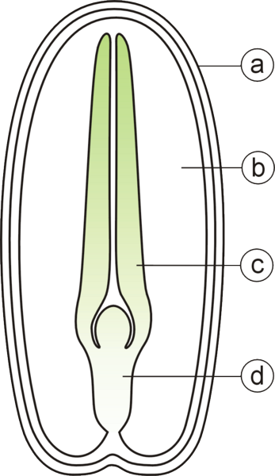
What is a Seed?
A seed consists of a plant embryo and endosperm enclosed by a seed coat
Seed Coat
Endosperm
Cotyledon
Hypocotyl

Slide 6
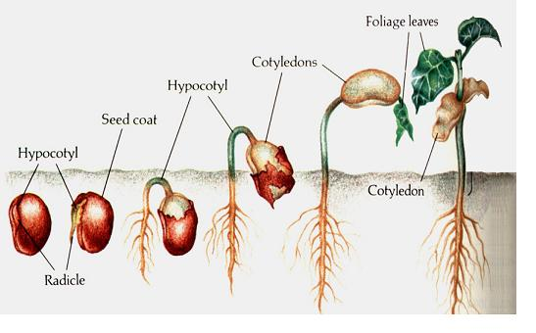
What Does a Seed Do?
Allows a plant to easily disperse offspring
Mature embryo inside
Can germinate anywhere with favorable conditions
Remains dormant until conditions are favorable

Slide 7
Why Study Seeds?
Seeds are a major source of nutrients
Also, by manipulating the seeds themselves, farmers may have a more successful crops
Design seeds to germinate earlier or in unfavorable conditions (drought, flood, etc.)
Easy Dispersal of Genetically Modified Crops
Mature embryo inside
Help developing countries

Slide 8
SEED DEVELOPMENT

Slide 9
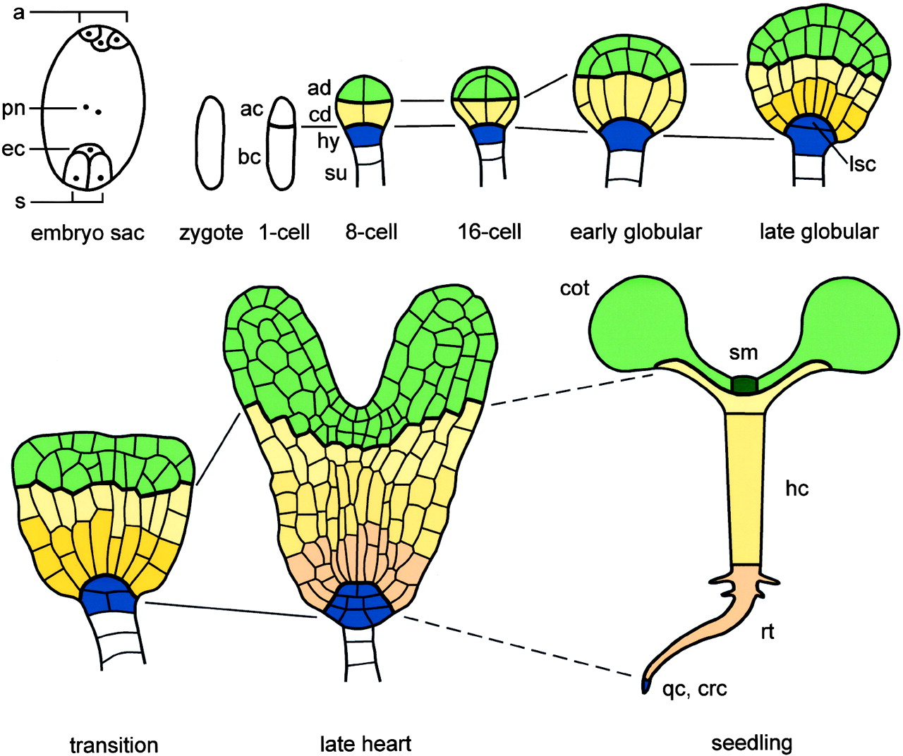
How Does a Seed Develop?
Double Fertilization
Development of the Embryo and Endosperm
Cell expansion and maturation

Slide 10
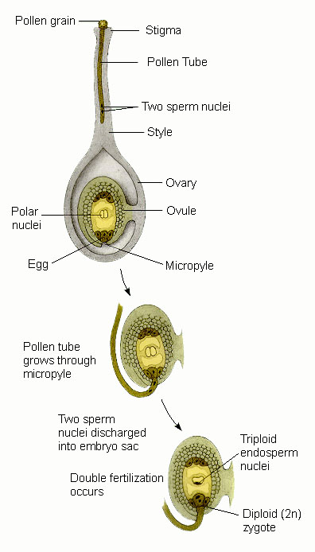
What is Double Fertilization?
Double Fertilization
Two sperm cells from the pollen grain enter the ovary by a pollen tube
One sperm cell fertilizes the egg cell
One sperm cell fuses with two polar nuclei

Slide 11
What is Cell Differentiation?
Cell Differentiation in the Embryo Proper
Formation of protoderm (Future Epidermis)
Differentiation of ground meristem and procambium
Ground meristem will form the ground tissue
Procambium will form the vascular tissues (xylem and phloem)

Slide 12
How Does an Embryo Develop?
Development of the Embryo and the Endosperm
2n cell from sperm and egg develops into embryo
Zygote divides into upper pole (apical cell—gives rise to the mature embryo) and the lower pole (micropylar pole, a large basal cell that gives rise to the suspensor) establishing polarity which just means that one end is different from another
3n cell from sperm and polar nuclei develop into endosperm

Slide 13
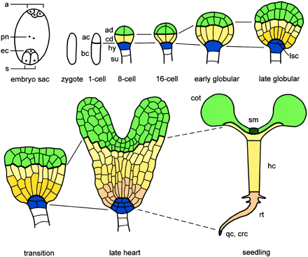
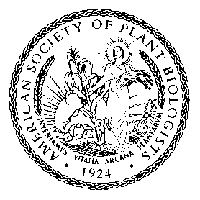
Apical-Basal Arabidopsis Embryo Development
Copyright ©2004 American Society of Plant Biologists

Slide 14
Stages of Development?
Cell Expansion and Maturation
Globular stage
Spherical embryo proper
Heart Stage
Development of cotyledons
Torpedo Stage
Cotyledons and primary meristems elongate

