Slide 1
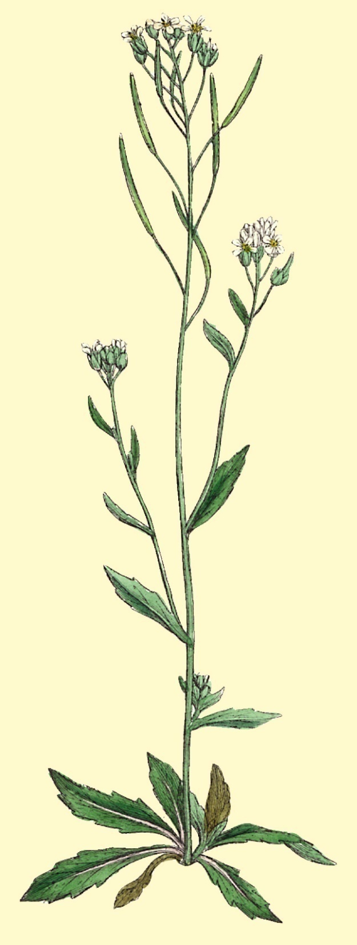
WRKY 59 and Agamous-Like 69 Genes
By Eden Maloney
HC70AL Spring 2009

Slide 2
What is AT2G21900?
2,074 Base Pairs
609 Exon Base Pairs
On Chromosome 2
3’ 5’ Orientation
Encodes for ATWRKY59
Member of WRKY Transcription Factor
202 Amino Acids

Slide 3
What is a WRKY Gene?
ATWRKY59
member of WRKY Transcription Factor
Helps plants react to stresses
wounding, drought, temperature changes, and pathogens
Senescence
Trichome development (epidermis outgrowths)

Slide 4
What is the Structure of AT2G21900?
Orientation
5’
3’
221 bp
101 bp
162 bp
1,364 bp
AT2G21895
220 bp
AT2G21905
812 bp
2,944 bp
Exon
Intron
Start
bp= base pairs
Stop
bp= base pairs
*no UTR

Slide 5
Where is T-DNA Insertion Site? (COMPLEMENT STRAND)
LBb1
Expected Wild Type Size: 610 bp
Expected T-DNA product Size: 363 bp
T-DNA Insert
Salk_012984
Forward Primer
Reverse Primer (compliment)
7 bp from 5’ end
1457 bp from 3’ end
5’
3’
80 bp
82 bp
Orientation
Stop
Exon
Intron
Start

Slide 6
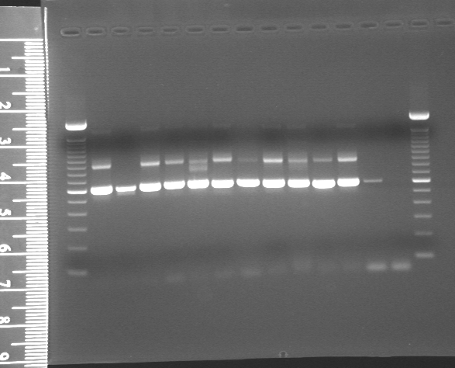
Genotyping Results
Plant #13
Plant #14
Plant #15
Plant #16
Plant #17
Plant #18
Plant #19
Plant #20
Plant #21
Plant #22
100 bp ladder
Plant #23
100 bp ladder
Positive Control
Plant #1
Plant #2
Plant #3
Plant #4
Plant #5
Plant #6
Plant #7
Plant #8
Plant #9
Plant #10
Plant #11
Plant #12
Negative control
Positive Control
Negative control
T-DNA insert
Homozygous Wild Type
Hemizygous T-DNA insert
Wild Type
4/16/09
1.5% Agarose Gel
Run at 120 volts for 1 hour
FW+RV+LBb1
5/28/09
1.5% Agarose Gel
Run at 120 volts for 1 hour
FW+RV+LBb1
Expected Wild Type Size: 610 bp
Expected T-DNA product Size: 363 bp

Slide 7
What Do My Results Mean?
Phenotype | Number of Individuals | Percentage of Phenotype Occurrence
Homozygous Wild-Type | 8 | 34.7%
Hemizygous T-DNA Insert | 15 | 65.2%
Homozygous T-DNA insert | 0 | 0%
Total Number of Individuals | 23
T-DNA insert is most likely lethal

Slide 8
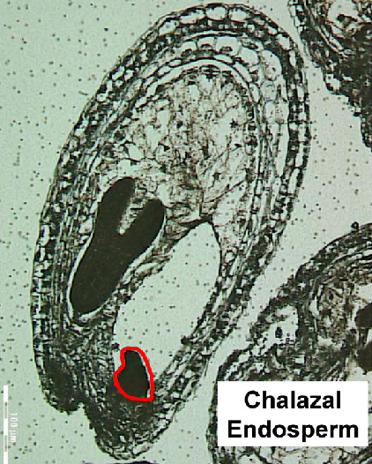
Where is the Gene Active? Gene Chip Data Summary
Estdb.ucla.edu/seed

Slide 9
RT-PCR Analysis of Leaf and Silique Tissue
No visible results for Leaf +RT or Silique +RT
Low Expression of Gene
Expressed in few cells
Expressed during a different time in development than analyzed
No Transcription in those tissues
Leaf +RT
Leaf -RT
Silique +RT
Silique -RT
Sterile Water (heg)
Genomic DNA (pos)
100 bp ladder
Tubulin RNA
AT2G21900 RNA
Tubulin + RV + FW
5/29/09
1.5% Agarose
120 volts for 1 hour
DNA Contamination

Slide 10
Phenotypic Differences Light Microscopy and Nomarksi Microscopy
Wild-Type Homozygous
Hemizygous T-DNA Insert
Chalazal Endosperm
There were no notable mutant phenotypes seen through light microscopy or Nomarksi microscopy
Chalazal Endosperm is hard to visualize

Slide 11
What is Another Way to Study Gene Expression?
Promoters bind to transcription factors which initiates transcription
Amplification, Ligation, Transformation, Selection, Digestion, Genotyping, Sequencing
Can be engineered to GFP or GUS to visualize gene transcription
!kbp ladder
Colony #1
Colony #2
Colony #3
Colony #4
Colony #5
Colony #6
4,200 bp
pENTR + promoter region
2,850 bp
pENTR
Transformed E. Coli Plasmids digested with Asc1
5/12/09
1.0 % Agarose
120 volts for 1 hour
1 kb ladder

Slide 12
What is AT5G06500?
On Chromosome 5
729 Exon Base Pairs (No Introns or UTR)
5’ 3’ Orientation
Encodes for Agamous-Like 96
Responsible for development of flower organs
243 Amino Acids

Slide 13
What is Agamous-like 96?
Part of Agamous Family of Transcription Factors
Essential for development of reproductive organs in flowers
Also important for the development of tissues derived from double fertilization in flowering plants.

Slide 14
What is the Structure of AT5G06500?
Orientation
5’
3’
AT5G06490
729 bp
AT5G06510
3, 854 bp
2,266 bp
bp= base pairs
*no UTRs or Introns
Stop
Exon
Start

Slide 15
Where is the T-DNA Insertion Site in AT5G06500?
LBb1
Salk_076290
T-DNA Insert
Expected Wild Type Size: 840 bp
Expected T-DNA product Size: 569 bp
Forward Primer
Reverse Primer (compliment)
108 bp to 5’ end
3 bp from 3’ end
5’
3’
Orientation
Stop
Exon
Start

Slide 16
Genotyping Results
WILD-TYPE
Expected :840 bp
Observed: ~850 bp
T-DNA Insert
Expected: 569 bp
Observed: ~575 BP
Homozygous
T-DNA
100 bp ladder
Plant #1
Positive Control
Plant #2
Plant #3
Plant #4
Plant #5
Plant #6
Plant #7
Plant #8
Plant #9
Plant #10
Plant #11
Plant #12
Negative control
Wild Type
5/21/09
1.5% Agarose
120 volts for 1 hour
FW+RV+LBb1

Slide 17
What Do My Results Mean?
Phenotype | Number of Individuals | Percentage of Phenotype Occurrence
Homozygous Wild-Type | 2 | 20.0%
Hemizygous T-DNA Insert | 0 | 0.0%
Homozygous T-DNA insert | 8 | 80.0%
Total Number of Individuals | 10
The T-DNA insert does not cause seed mortality

Slide 18
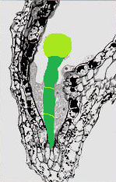
Where is the Gene Active: Gene Chip Data Summary
Micropylar Endosperm
Biology.kenyon.edu

Slide 19
Where is the AT5G06500 Active?
Again no visible results for either silique or leaf tissue
Micropylar Endosperm and Suspensor form a small portion of the seed
Thus, the gene may be expressed, but not at detectable levels
Tubulin + RV + FW
100 bp ladder
Leaf +RT
Leaf -RT
Silique +RT
Silique -RT
Sterile Water (heg)
Genomic DNA (pos)
5/29/09
1.5% Agarose
120 volts for 1 hour
RT-PCR Product
Expected: 249 bp
Observed: ~200bp
Tubulin
Observed: ~470bp

Slide 20
Phenotypic Differences
Homozygous T-DNA Insert
Homozygous Wild-Type
Micropylar Endosperm
Micropylar Endosperm
Plant 10
Borrowed from MB

Slide 21
Significance of Results
AT2G21900
AT5G06500
The knock out of gene AT2G21900 most likely causes seed lethality
No mutant phenotypes observed for the knock-out lines
Tissues where expressed are hard to visualize with light and Nomarski microscopy
The knock out of gene AT2G21900 does NOT cause seed lethality
No mutant phenotypes observed for the knock-out lines
Tissues where expressed are hard to visualize with light and Nomarski microscopy

Slide 22
What Further Research Can Be Done?
Use more complex phenotype analysis tools to analyze the Micropylar Endosperm, the Suspensor, and Chalazal Endosperm.
Screen more plants for gene one to see if there are any homozygous T-DNA insert plants
Do more RT-PCR experiments for both genes to try and detect where the genes are transcribed

Slide 23
Acknowledgements
Thank you:
Dr. Golberg, Anhthu, Daisy, Kristin, Brandon, Ingrid, and everyone else in Dr. Goldberg’s Lab
For your tremendous effort, patience, and time put into mentoring us. It has been the most challenging and rewarding 20 weeks of my academic career.
Also, thank you Chris, Elaine, Jessica, Max, and Nancy for the supportive and entertaining atmosphere.

