Slide 1
The MYB and BHLH
Transcription Factor Families
by
Elaine Chiu

Slide 2
AT5G61620
is a MYB family transcription factor
Located on Chromosome 5 of the
Arabidopsis thaliana
What are MYB family
transcription factors?

Slide 3
What are MYB family transcription factors?
- Myeloblast → MYB (came from first identified MYB, which was in an avian oncogene)
3 Repeats: R1, R2, R3
In Arabidopsis, almost all of the MYB proteins belong to the MYB-R2R3 class
Structure: Helix-turn-Helix: two alpha helices joined by a short strand of amino acids. This structure is found in many proteins that regulate gene expression.
Functions in the Arabidopsis : Essential for hair cells in leaf and stem. Activate genes to respond to dehydration and salt stress.

Slide 4
What is the Structure of AT5G61620?
321-393
607-705
5’
3’
Exon 1
Exon 2
Exon 3
1-320
394-606
706-1129
-Size of gene: 1125bp (1.1KB)
-Located on chromosome 5
On the Forward strand
3 exons and 2 introns

Slide 5
Where is the T-DNA inserted in AT5G61620?
LBb1
T-DNA
Fw
Rv
3’
5’
Exon 1
Exon 2
Exon 3
1-320
394-606
706-1129
T-DNA is located n735-1110
Expected size Fw+LBb1: 1165bp (1.2KB)
Expected size Fw+Rv: 1019bp (1KB)
Because WT and T-DNA bands only differ in length by 150bp, need to set up separate PCR reactions

Slide 6
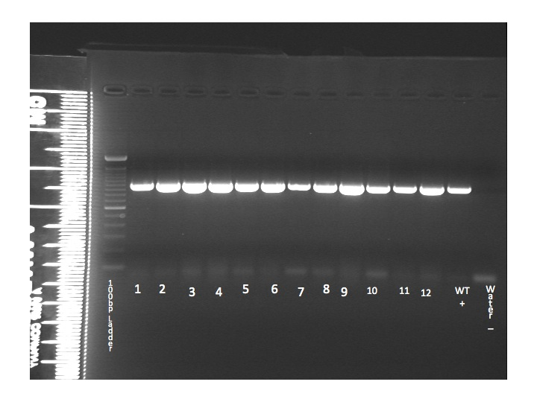
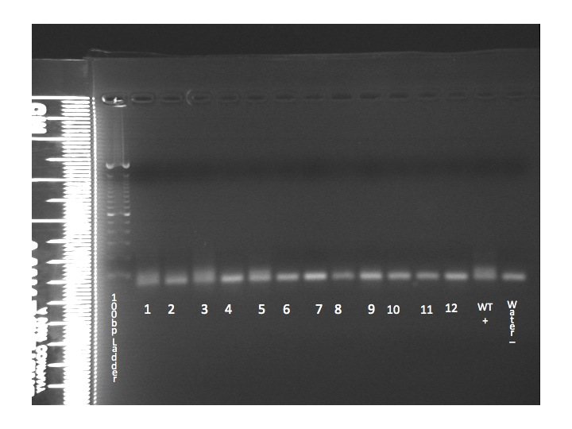
What are the Genotypes of my plants?
WT band 1KB
1.5% gel run
For 35min at 148V
First 12 plants
Fw+LBb1
Fw+Rv
WT band 1KB
1.5% gel for
44min at 143V
6 More Plants
Fw+Rv
Fw+LBb1
Conclusion: All 18 plants are WT. Indications?

Slide 7
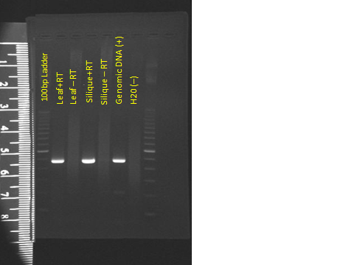
Where is AT5G61620 Active?
Microarray
Embryo Proper
PG
Peripheral
Endosperm G
1.5% gel run
for 1hr at
120V
Peripheral
Endosperm PG
WT
+
H20
–
1K Ladder
13
14
15
Positive control has
band with expected
size of AT5G61620
16
17
18
Seed G
RT-PCR indicates AT5G61620 is neither
active in the leaf nor silique tissues,
which contradicts with microarray
results.
Suspensor G

Slide 8
Is there another method of determining where a gene is active?
Answer: OH YEAH!
Technique: Insert the promoter region of a gene into the promoter of another vector containing GUS and GFP. Then transform a plant with this vector using Agrobacterium and examine its offsprings for any blue color or glowing feature.
Before amplifying and cloning upstream region,
Should know expected size of PCR products
Promoter region: 1.4KB
pENTR vector: 2.5KB
Expected recombinant plasmid: 3.9KB
WT
+
H20
–
1K Ladder
13
14
15
16
17
18

Slide 9
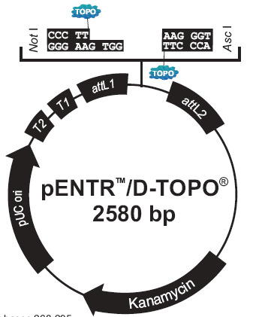
What are the steps to cloning the
promoter region?
1.Amplify promoter
Region using PCR.
2. Verify expected size of PCR
product.
1% gel run
for 32min
at 149V
1.4KB
3. Ligation
WT
+
H20
–
13
14
15
16
17
18

Slide 10
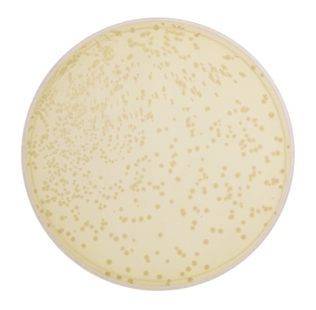
How to verify colonies contain recombinant plasmids?
1.
2.
3KB
1% gel run
for 1hr at
120V
1% gel run
for 44min at
118V
Expect 4KB
PCR on
tranformed
E.coli
solutions
reveal
no inserts
1.Transformation.
Plate. Total of
16 colonies.
2. Screen colonies.
All 6 colonies have
something inserted,
but the inserted fragment is too small to be the cloned upstream region of AT5G61620.
WT
+
H20
–
13
14
15
16
17
18
3.
3. Sequence. Results Eden’s
gene (AT2G47190) and
AT5G46770.
Conclusion: primers not specific enough.

Slide 11
AT1G61660 is a BHLH Gene located on the Chromosome 1 of the Arabidosis thaliana genome.
But what are BHLH Genes?

Slide 12
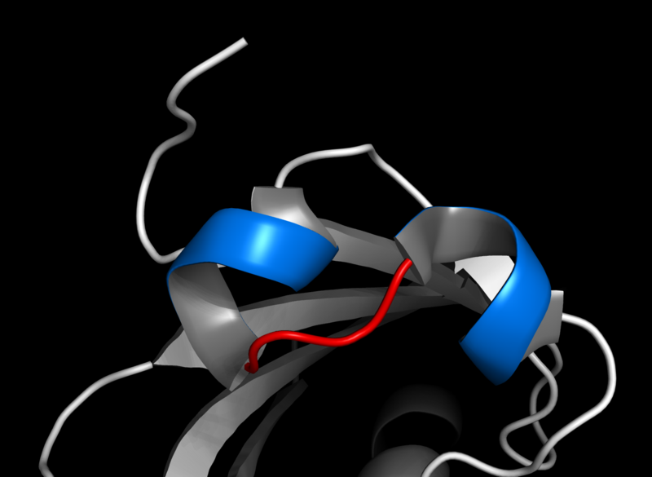
What are BHLH Genes?
BHLH
(Basic-helix-loop-helix):
Consists of 2 alpha-helices connected to a loop. The larger helix contains the DNA-binding regions.
154 members for this family, 122 of which are present in
the Arabidopsis
Binds to a consensus sequence called an E-box (CANNTG)
The BHLH family contains proteins that perform a wide range of
different roles in plant cell and tissue development.

Slide 13
What is the Structure of AT1G61660?
1816-2179
1563-1662
1413-1507
1216-1345
1062-1148
856-952
325-445
5’
3’
Exon7
Exon 6
Exon 5
Exon4
Exon 3
Exon2
Exon 1
1663-1815
1346-1412
953-1061
1-324
1508-1562
1149-1215
446-885
On Minus Strand
-Size of gene: 2581bp (2.6KB)
-Located on Chromosome 1
-On the Minus strand
-7 exons and 8 introns

Slide 14
Where is the T-DNA Inserted in AT1G61660?
LBb1
T-DNA
Rv
Fw
5’
3’
Exon7
Exon6
Exon5
Exon4
Exon3
Exon 2
Exon 1
953-1061
1663-1815
1508-1562
1346-1412
1149-1215
446-885
1-324
T-DNA is located n558-687 in AT1G61660
Expected size of Fw+Rv = 818bp
Expected size of Fw+LBb1 = 493bp

Slide 15
What Are the Genotypes of My Plants?
1.5% gel run for
37min at 146V
Plants 2, 5, 8, 9,
and 10 are
Homozygous
T-DNA Plants
This means…
That the effects of a knocked-out AT1G61660 can be analyzed using Light and Nomarski microscopy!
8

Slide 16
Does Knocking Out AT1G61660 Cause Seed Lethality?
No. Since many homozygous T-DNA plants survived, knocking out AT1G61660 does not cause seed lethality.
Wild Type | Hemizygous | Homozygous T-DNA
4 | 2 | 5

Slide 17
Where is AT1G61660 Active?
1.5% gel run
for 37min
at 146V
G
Hrt
Chalazal seed coat
LC
MG
PG
leaf
RT-PCR
AT1G61660 is active in the leaf and silique (seed)
Microarray
This gene is expressed in the seed! Now what?

Slide 18
Are there any phenotypic differences between the seeds of a homozygous T-DNA plant and those of a wild type plant?
Steps to analyze features of the seed:
1. Light Microscopy
2. Nomarski Microscopy
Defective seed coat
Chalazal seed
Coat appear
The same
Conclusion: It is likely that I damaged the seed coats in that one silique since results are not consistent with other siliques and Nomarski.

Slide 19
Future Experiments?
AT5G61620
All WT plants
- Sow more seeds!
AT1G61660
No phenotypic defects detected using Nomarski
Collect seeds from homozygous plants, sow, and examine entire plant
Examine at the protein level

