Slide 1
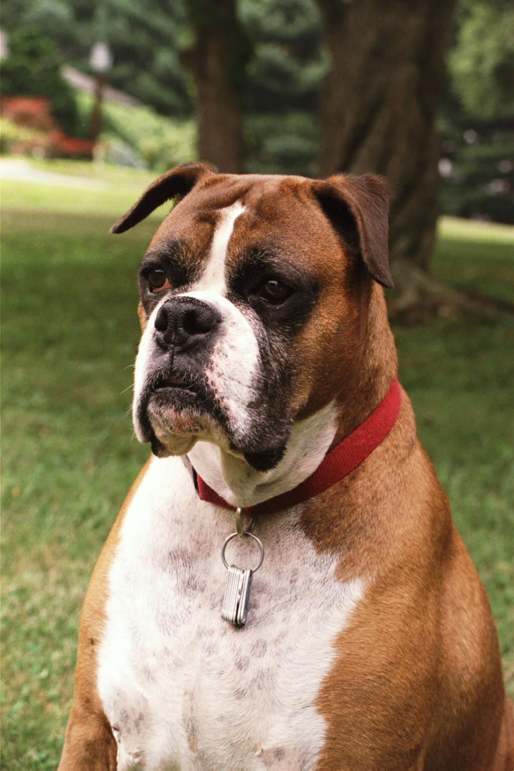
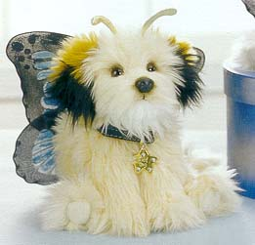
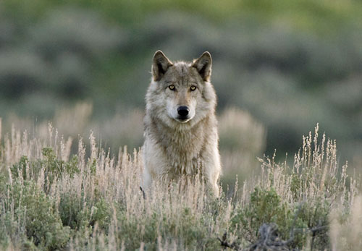
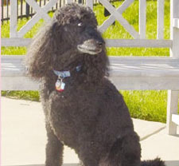
Engineering of the Dog and wild relatives
Tasha
Shadow

Slide 2
TALK OUTLINE
1) Introduction
a) Evolutionary framework
b) Origin and diversification
c) The dog as a model species
d) The canine genome and canmap projects
2) How to build and reverse engineer a dog
a) Three ways to build a dog
b) Association and selective sweep mapping
c) IGF1,the body size gene
d) Legs and fur
e) The number of genes
f) Evolving the dog
3) Engineering of the wild
a) Black and gray coat colors of wolves
4) The future
a) Exome capture and complete genome sequencing

Slide 3
Relationships of Carnivora Families
a. The evolutionary framework

Slide 4
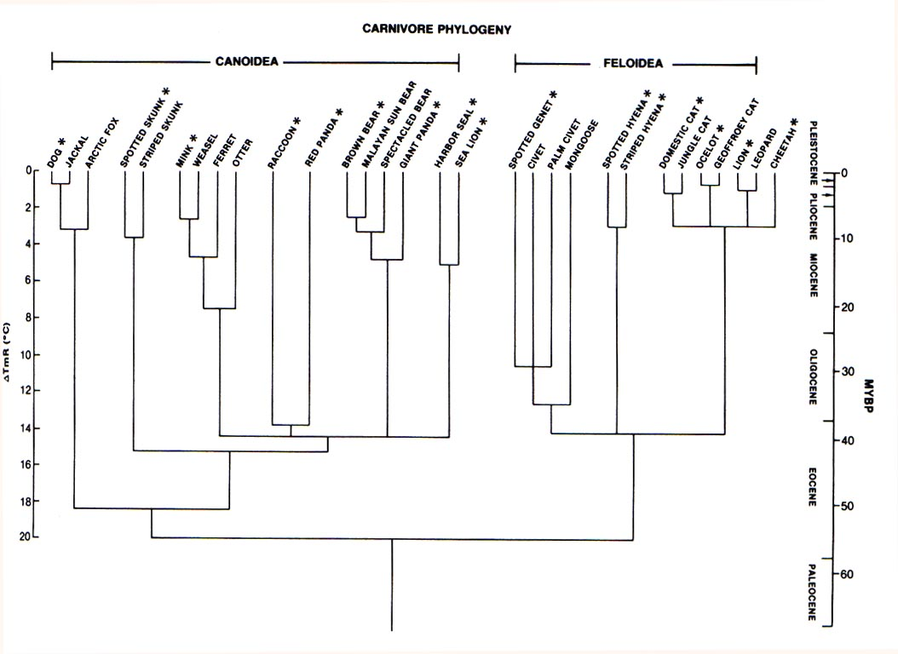
Canidae
Wayne et al. 1989

Slide 5
Evolution of Canidae
Borophaginae
Caninae
Hesperocyoninae

Slide 6
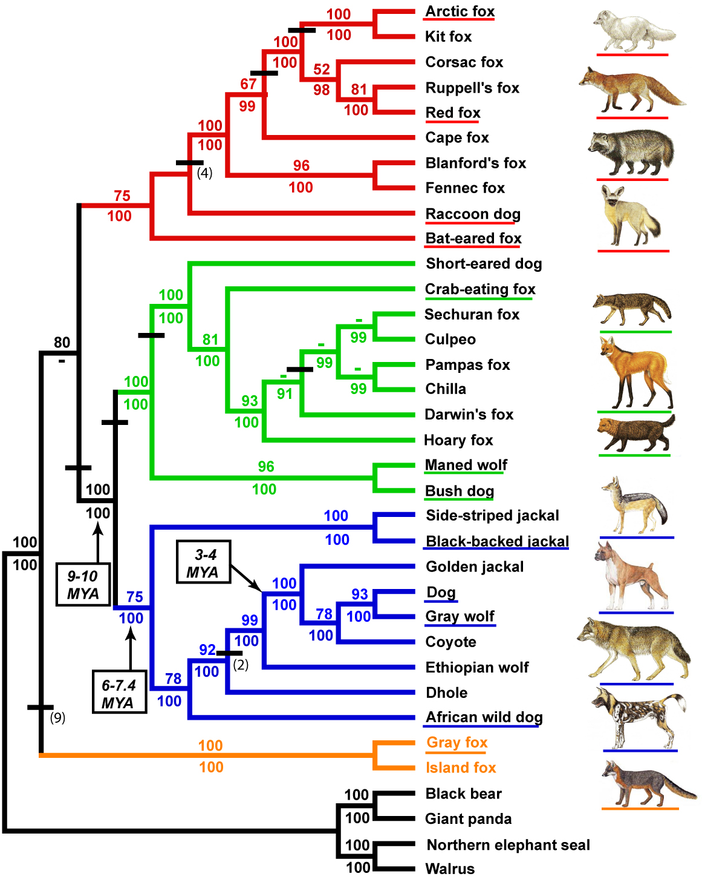
Indels
Lindblad-Toh et al., Nature, 2005

Slide 7
CONCLUSIONS
1) The dog has an ancient divergence from other carnivores dating to about 55 million years ago.
2) The extant Canidae has a relatively recent origin about 10 million years ago and is divided into three primary groupings. The dog is assigned to the wolf-like group.
3) The dog is extremely close to gray wolves and shows no evidence of origin from other wolf-like canids.

Slide 8
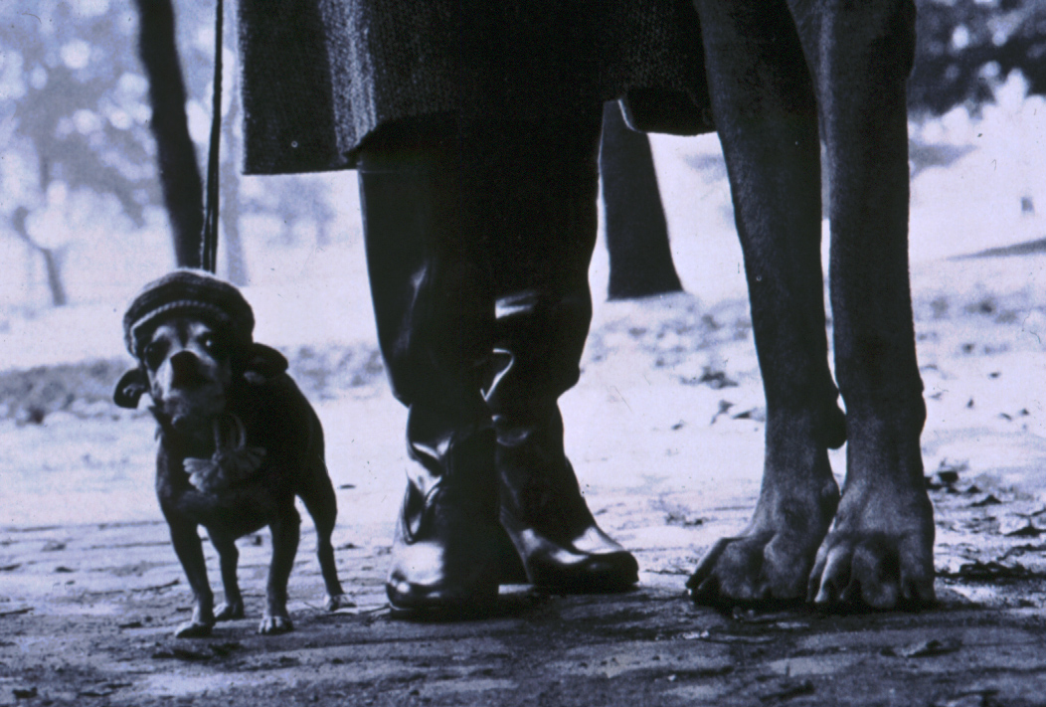
CHIHUAHUA
HOMO SAPIENS
GREAT DANE
b. ORIGIN AND DIVERSIFICATION

Slide 9
QUESTIONS
1) When did the domestic dog originate?
2) Where did the dog originate
(from a single population & region)?
3) How have humans directed the evolution of dogs?

Slide 10
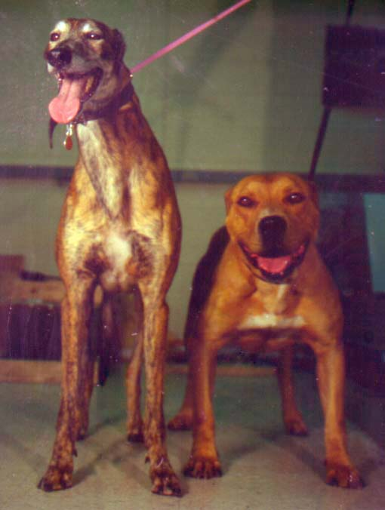
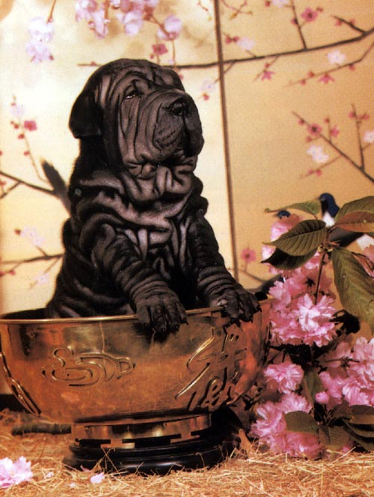
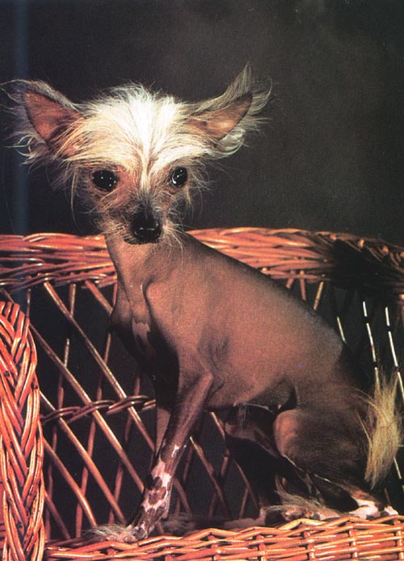
Cell
Mitochondrial DNA (mtDNA)
One linked array of genes
One locus
Control region sequence
Maternally inherited
Mitochondria
(~18,000 base pairs)
…ATCATCCC… Specimen 1
…ATCTTCCC… Specimen 2
Nucleus
(~ 3 billion base pairs)
140 dogs from 67 breeds
162 wolves from 27 populations
Vilà et al., Science, 1997

Slide 11
The sequence diversity within dogs is
similar to that within wolves
Average sequence divergence in dogs = 2.06% ± 0.07%
26 haplotypes in 140 dogs from 67 breeds
Average sequence divergence in wolves = 2. 1% ± 0.04%
27 haplotypes in 162 wolves from 27 populations
1 2 3 4 5 67
Dog 1 TT
A
G
C
T
G
T
C
GA
T
TC
CA
Dog 2 TT
A
G
C
T
A
T
G
GA
A
TC
GA
Gray Wolf 1 TT
T
G
C
T
A
T
G
GA
T
TC
CT
Gray Wolf 2 TT
T
G
G
T
A
T
G
GA
T
TC
CA

Slide 12
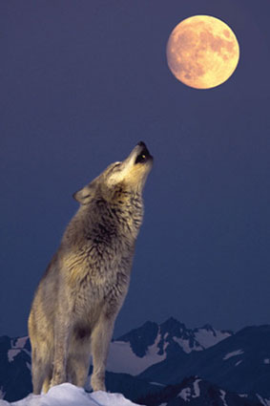
The ancestor of the dog is the wolf
261bp control region

Slide 13
Dogs breeds were founded by multiple matralines or interbred

Slide 14
The majority of dog sequences has a single common origin
Clade I contained only dog sequences and was the most diverse suggesting an ancient common origin

Slide 15
FOUR ORIGIN OR
INTERBREEINDING
EVENTS FROM WOLVES
1
2
3
Elkhound and Jämthund- Independent origin?
Recent interbreeding event?
4

Slide 16
The Timing of Domestication
Wolf/coyote divergence =
1 mybp, 7.5% sequence divergence.
Max divergence in dog clade I = 1.0% hence origin of sequence ~ 10- 100Kya
Vila et al., Science, 1997
Savolainen et al., Science, 2002
1030bp control region

Slide 17
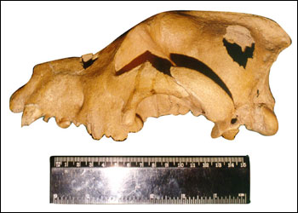
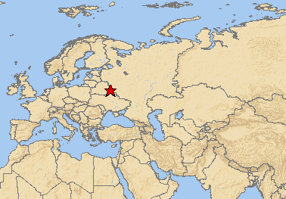
The Oldest dogs: 15-31K years ago
Huskies
Russian dogs
Gt. Danes
Wolves

Slide 18
Origin in East Asia
1. High diversity in East Asia suggests an origin there.
2. Founding by multiple matralines is consistent w/ origin 15 to 40k
East Asia
Europe
Southwest Asia
Savolainen et al., Science, 2002

Slide 19
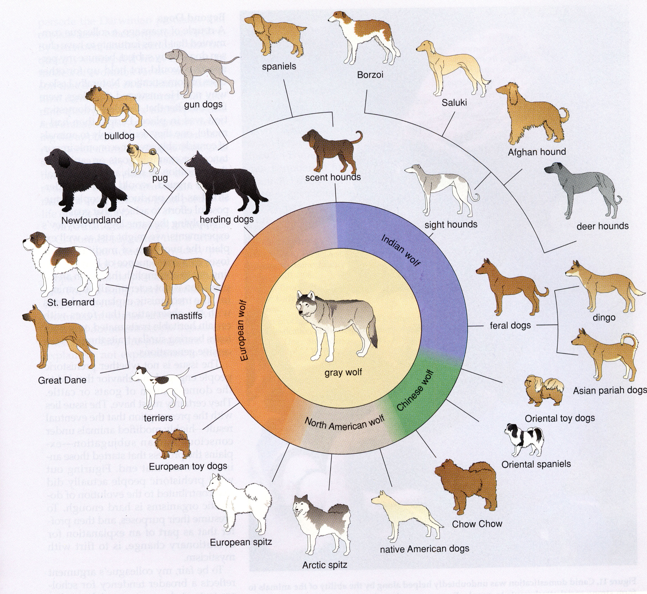
Diversification

Slide 20
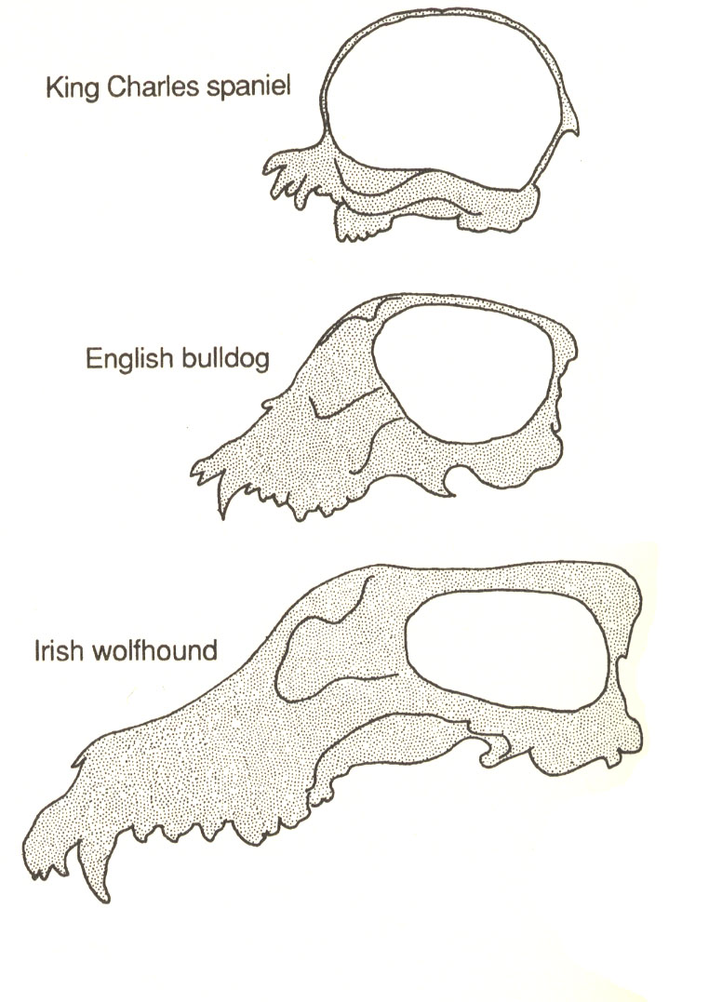
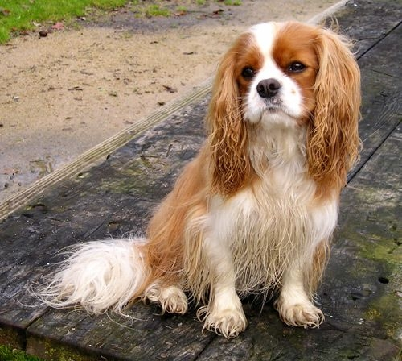
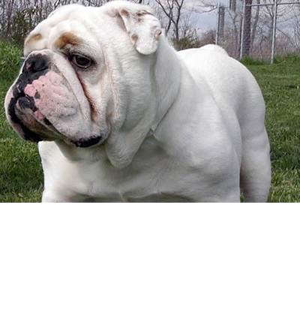
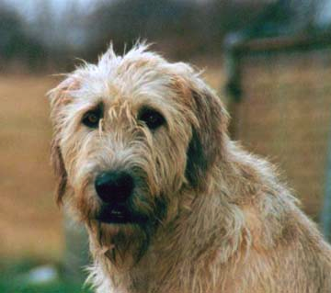

Slide 21
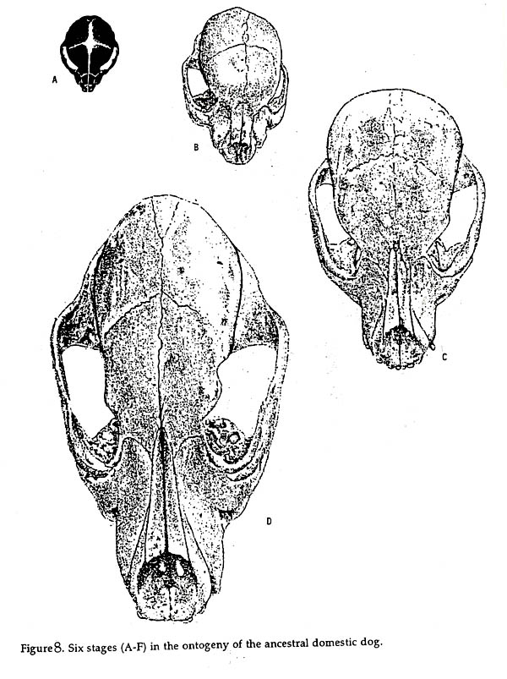
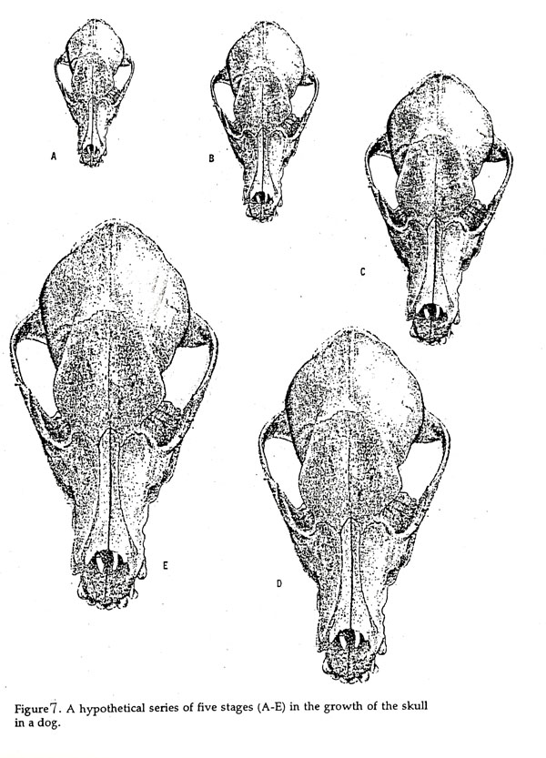
ISOMETRIC GROWTH
Allometric Growth
ALLOMETRIC GROWTH
Proportionate Growth

Slide 22
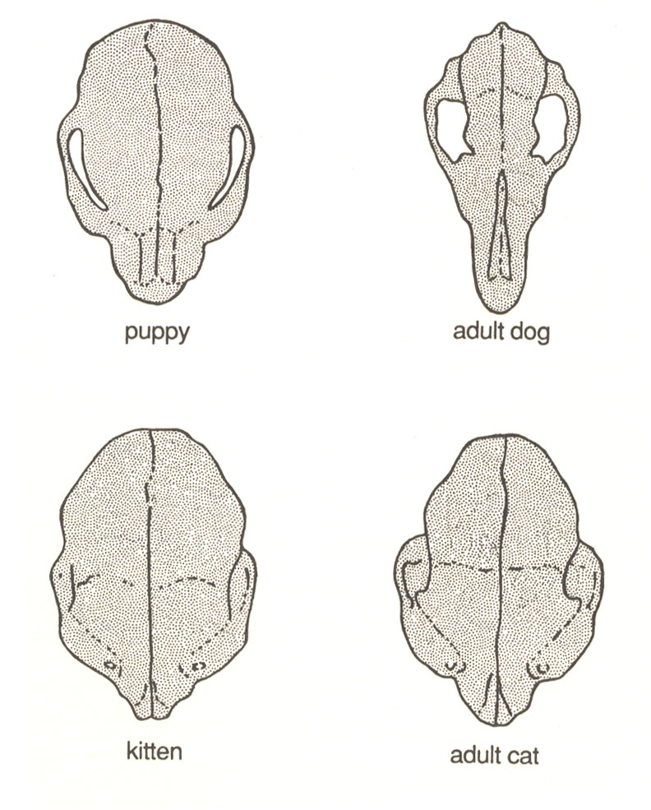
Wayne, Evolution, 1986

Slide 23
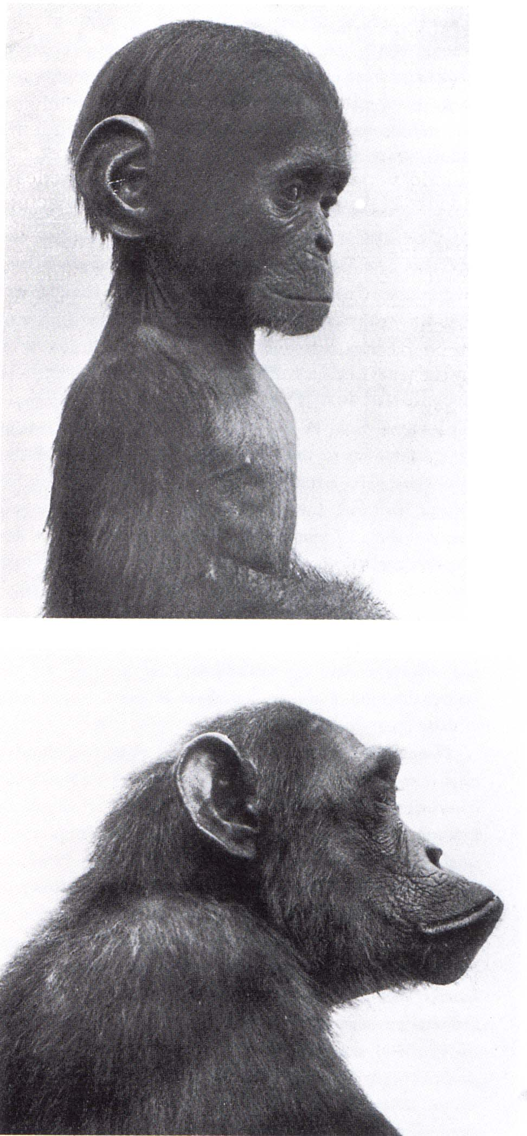
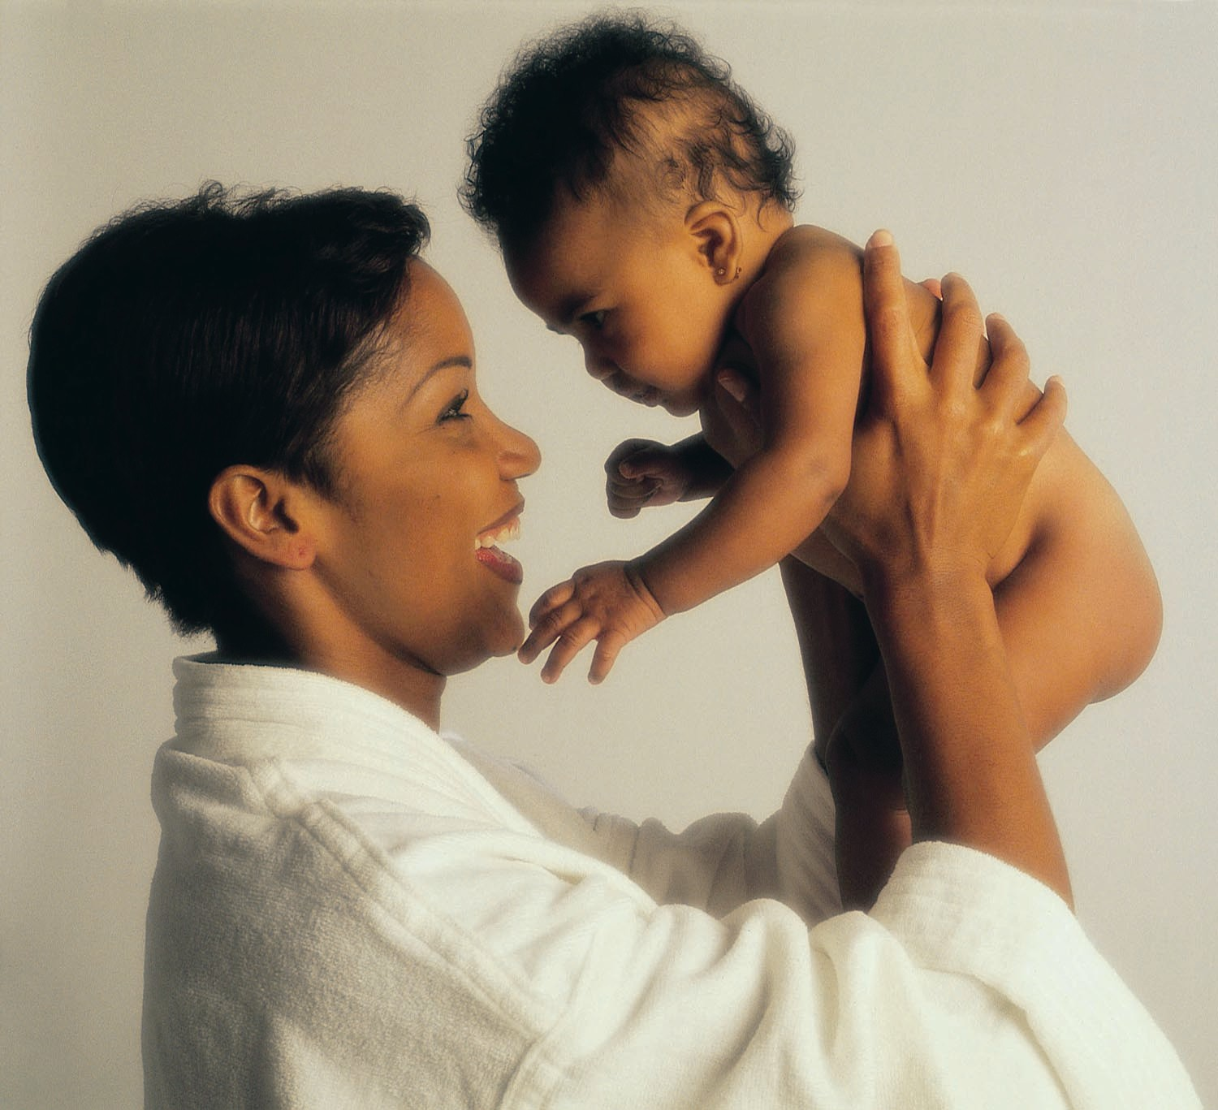
Neoteny (juvenilization)

Slide 24
CONCLUSIONS
1) The dog has high mitochondrial DNA sequence diversity suggesting a diverse origin from multiple wolf matralines from a wide region.
2) However, the higher diversity of dog mtDNA in east Asia suggest that dogs may have had a long history there.
3) Dogs are the oldest domesticated animals, originating 10-100,000 years ago.
4) Neoteny has been a common mode of change, affecting behavior and morphology.

Slide 25
Questions
The reason dogs appear to have evolved in East Asia is based on:
a. The fossil record
b. Historical record
c. Morphological studies
d. Higher mtDNA diversity
e. Lower mtDNA diversity
2) The apparent phenotypic diversity in skull shape in dogs as compared to cats reflects what general difference between the two species:
a. Selection for bite strength
b. Selection for bigger brain size
c. Occlusal and breathing limitations
d. Differences in developmental gradients
3) The dog is derived from:
a. an extinct species
b. a diversity of wolf-like species
c. gray wolves
d. none of the above

Slide 26
C. The Dog as a Novel Model Species

Slide 27
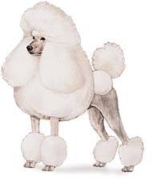
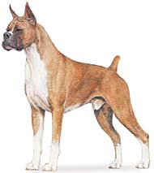
D. The Sequencing of the Dog
Dog Genome Resources
Complete genome sequenced - 2.4 Gb
Boxer – 7.5X coverage (Linblad-Toh et al., Nature, 2005)
Poodle – 1.5X coverage (Kirkness et al., Science 2004)
19,120 Dog genes predicted, nearly all with human homologs
2.1-2.6 Million SNPs generated from Boxer and Poodle complete genomes, 10 other dog breeds (100,000 sequence reads each), and 4 wolves and one coyote (20,000 sequence reads each)
127,000 Dog SNP microarray chip
Searchable annotated genome (e.g. UCSC Genome Browser, Ensembl) e.g. allows identification of new microsatellite or SNP loci in regions of interest
Syntenic map of Dog, Human, Mouse, Rat
Cost: 46 million dollars

Slide 28
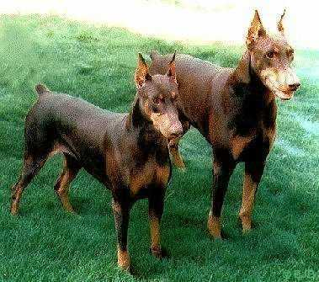
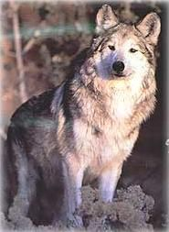
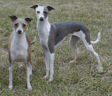
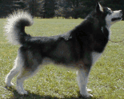
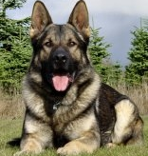
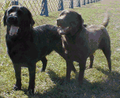
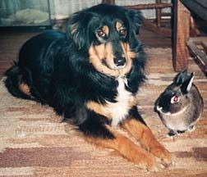
2.6 Million SNPs Total-SNP Every 5 Kb
The Dog Genome Project
Tasha vs. other breeds wolves and coyotes
26,551
Tasha vs.
Tasha
554,161
288,841
15,997
90,984
134,849
Tasha vs.
Poodle
1,390,677

Slide 29
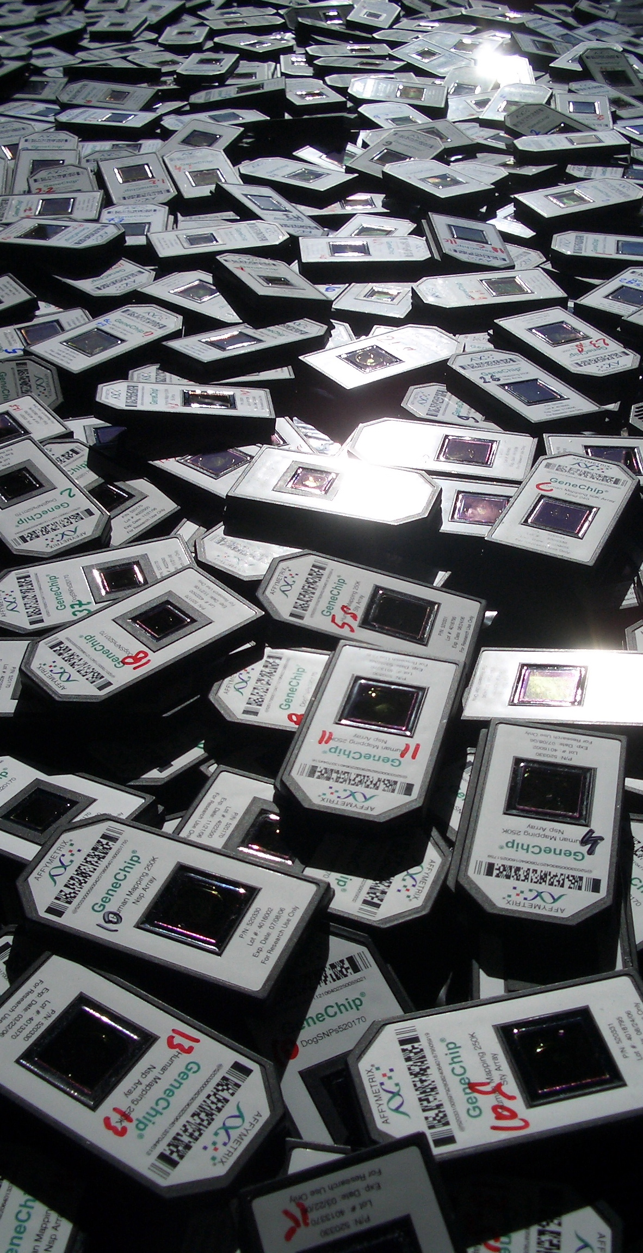
E. The CanMap Project (like the human hapmap project aims to characterize genomic variation)
CanMap Project:
Dr. Elaine Ostrander (NHGRI/NIH - CGB)
Dr. Robert Wayne (UCLA EEB)
Dr. Carlos Bustamante (Cornell/Stanford)
Affymetrix and Michele Cargill
127,000 SNPs (all Perfect Match oligos)
Magic genotyping algorithm- 50-70K
Quality assessment for standardizing across batches
Excluding SNPs:
When sample call rate is <95%
When SNP MAF < 1%
When SNP heterozygosity > 60%

Slide 30
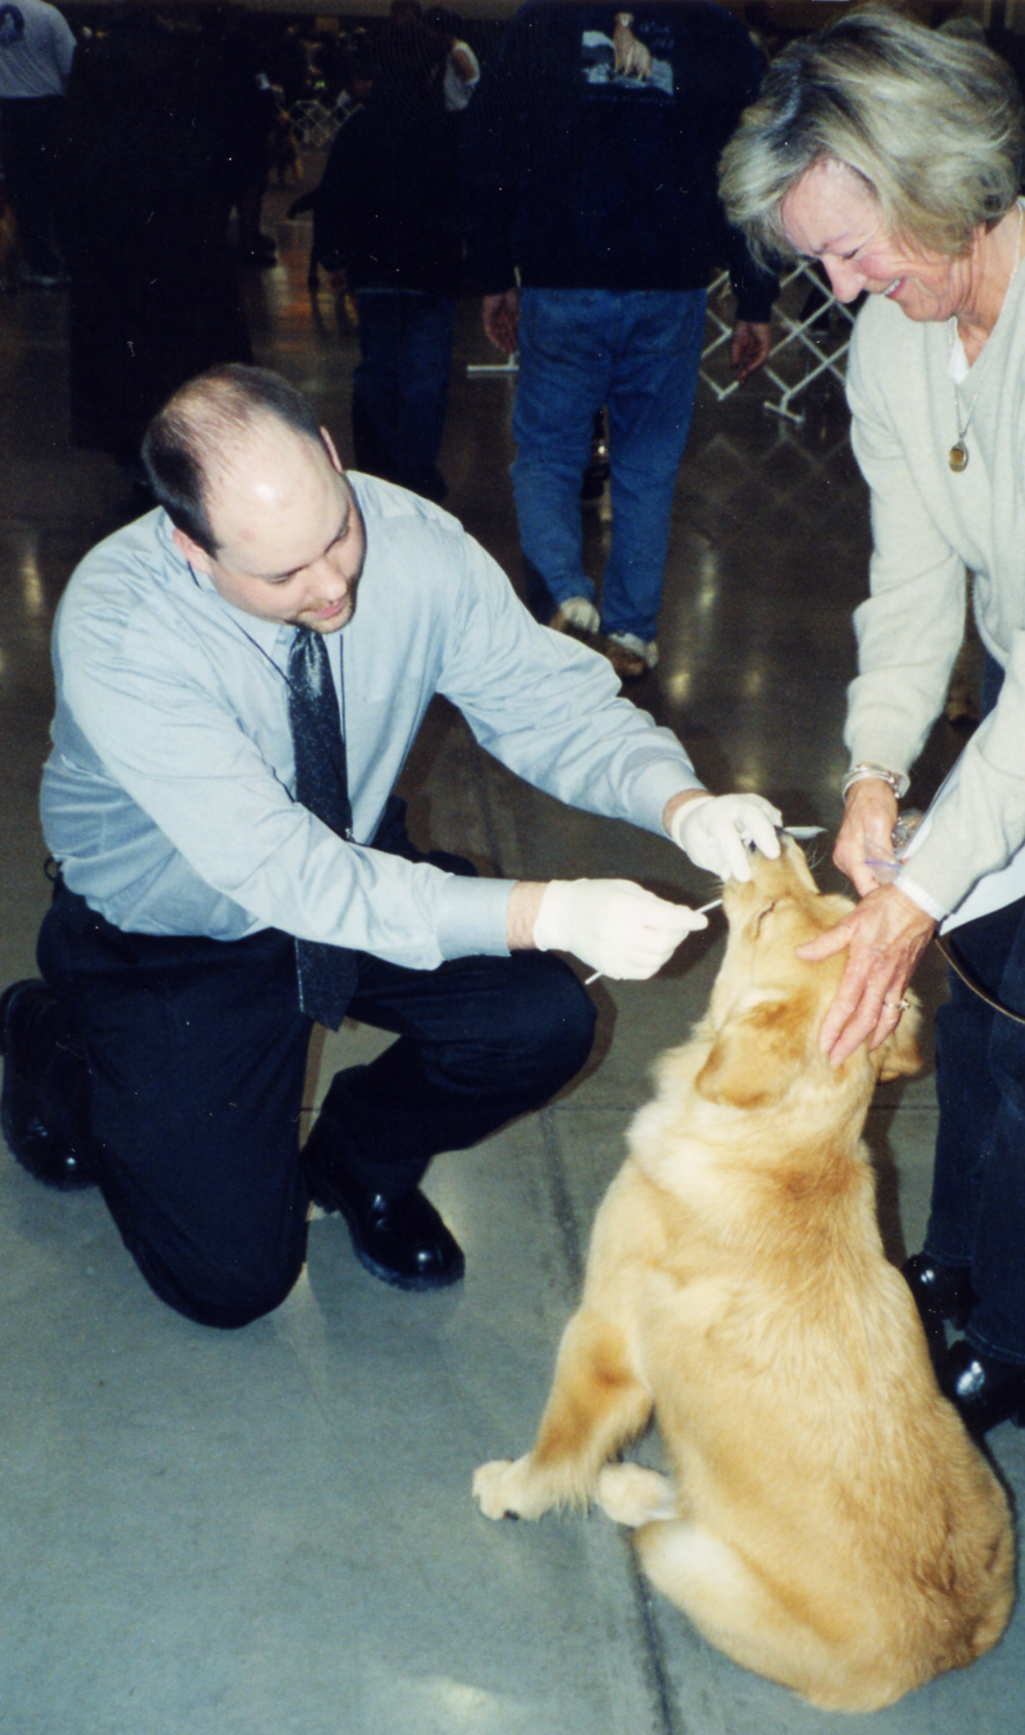
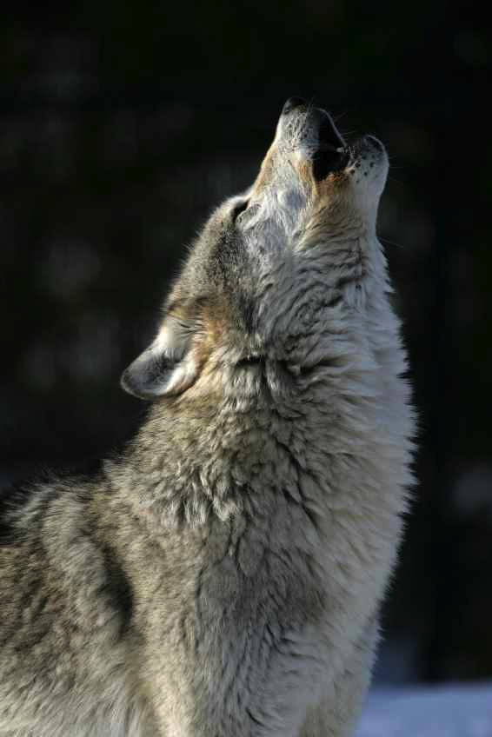
Samples
Collect DNA from 5-10 unrelated dogs from 85 breeds and gray wolves (the ancestor of dogs)

Slide 31
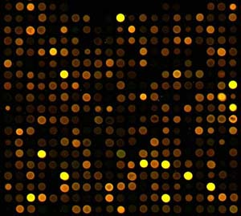
The Canine SNP genotyping microarray

Slide 32
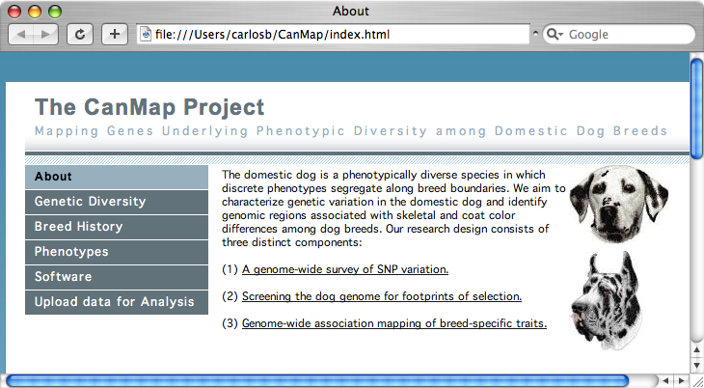

Slide 33
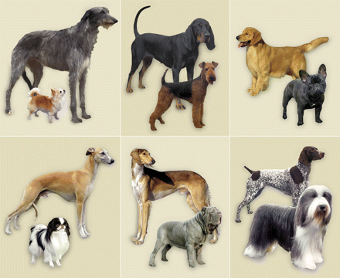
2. How to build a dog

Slide 34
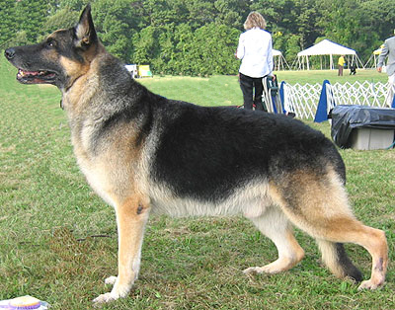
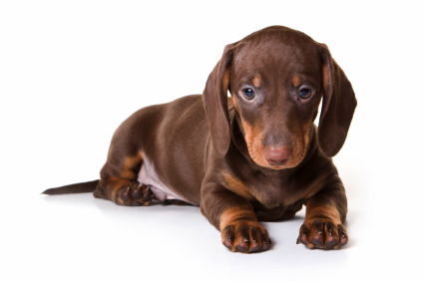
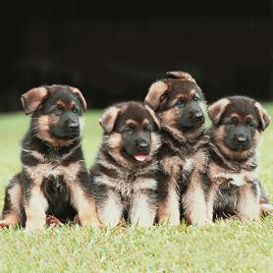
2a. How to build a dog
A. Fixing mutations of large effect
X

Slide 35
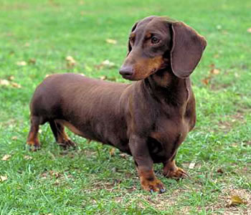
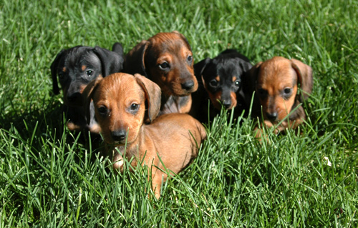
2. How to build a dog
B. Crossing distinct breeds
X

Slide 36
2. How to build a dog
C. Progressive “idea” driven selection
X
Shorter legs
X
X
X
X

Slide 37
Linkage and Association Mapping
b. Reverse engineering the dog

Slide 38
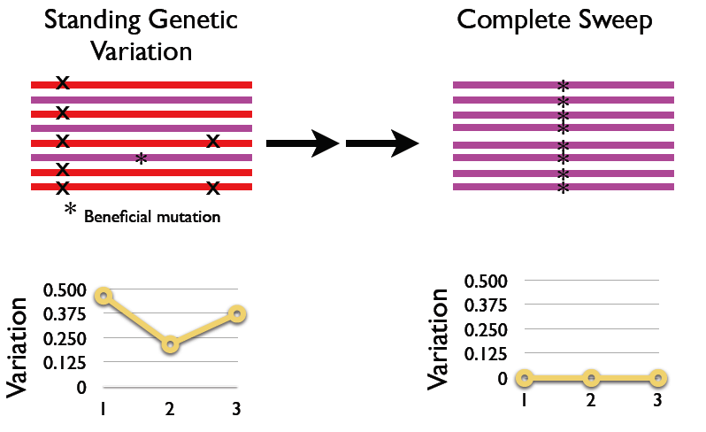
b. Selective Sweep Mapping

Slide 39
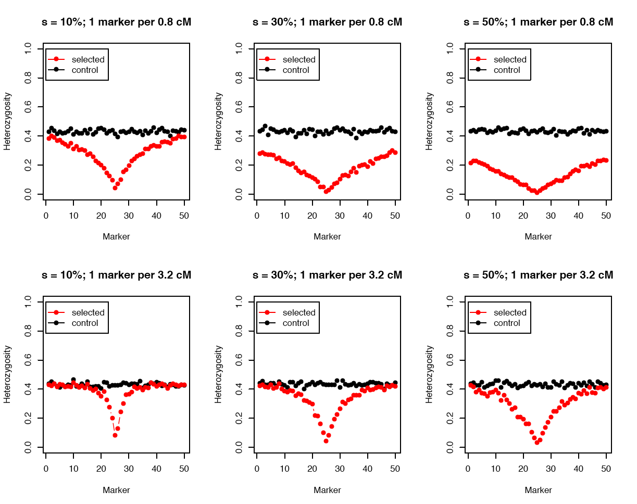
Pollinger et al., Genome Res., 2005

Slide 40
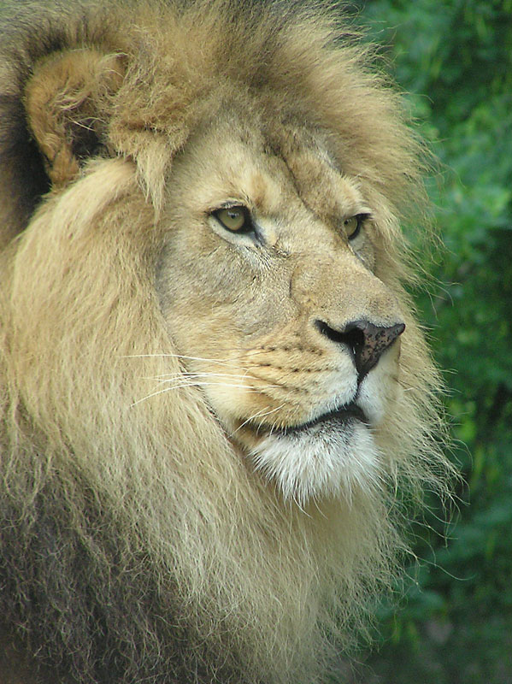
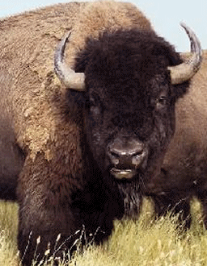
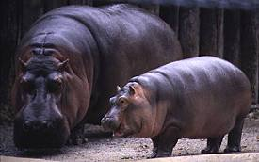
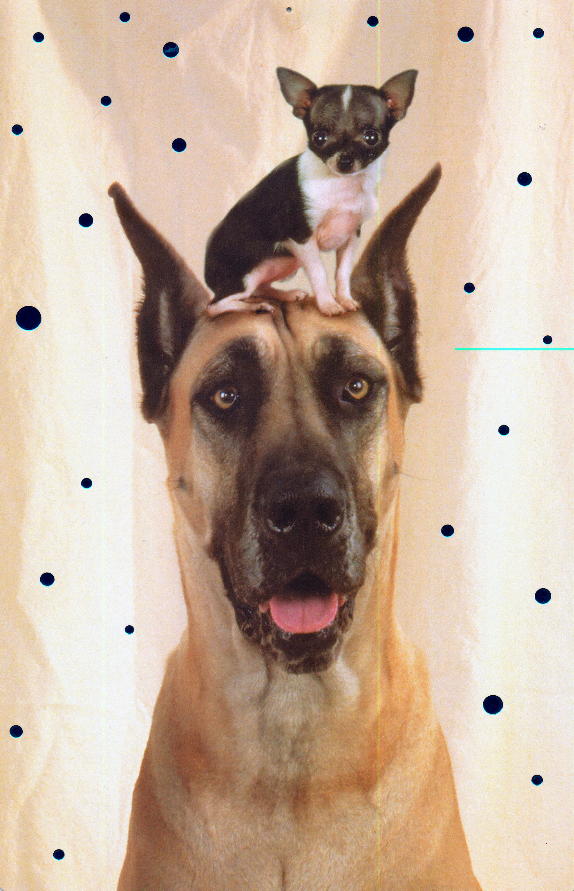
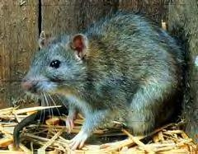
B. IGF1,the body size gene
African Elephant
Hippopotamus
American Bison
Lion
Domestic Dog
Rat
Deer Mouse
Pygmy Shrew
Bumblebee Bat
Sutter et al., Science, 2007

Slide 41
A General Approach For Finding Genes Under Selection (such as body size)
First, genome-wide association study in a single breed (Portuguese Water Dogs) that segregates size morphs to find markers associated with size
Second, selective sweep mapping in candidate regions in large and small dogs to find regions of reduced variation and high divergence.
Third, association mapping, find haplotypes that correspond with small size, narrow genomic interval

Slide 42
Step 1: Genome-wide scan Genotype, Measure Skeletal Phenotypes, and Do Principal Component Analysis
Focus on the Portuguese water dogs that have small and large morphs
Genotype 500+ pedigreed dogs at 500 microsatellite markers
Collect 91 skeletal measurements from x-ray images
Do principal component analysis, which classifies phenotypic variation into independent systems of correlated traits
Principal components are phenotypes so we can search for markers associated with them

Slide 43
Principal Component 1 (Skeletal Size)
0.15
skull
Hip
fore
hind
Trait Strength
0.10
0.05
0.00
Skeletal Measurement
PC1 is based on 42 metrics from pelvis, fore and hind limbs
Highly heritable (h² 0.45)
7 QTLs affect size
A locus of interest: FH2017 on CFA15 is linked to IGF1!
Extensive re-sequencing near IGF1 led to SNP discovery
Notes:
The first principal component represents overall skeletal size. Here you see the principal component represented as a bar graph. Each trait has a bar which shows the weighting for that trait. The weighting for a particular trait is referred to as the load for that trait. In the graphs that I will be presenting I have removed most of the traits with low loadings to give a cleaner picture of the principal component. Although each trait has a loading for each principal component, traits which have high magnitude loads greatly influence or define the principal component. In this case all of the traits have positive loadings of about the same magnitude and all of the skeletal systems are represented.
Overall skeletal size is significantly heritable, indicating that genes which determine body size are still segregating in this population. We were able to identify two separate QTLs fh2295 indicated in red and fh2587 in green. While both QTLs are significantly associated with the principal component they are significant for a different suite of the individual traits, as indicated by the red and green bars below the graph. The size of the bars indicates the significance of the association for each individual trait. For some traits they both are significant (skull width and skull length) for others one is significant but the other is not (cranial width and humerus length) and finally for some neither is significant (mandible span and outlet cavity). The fact that some of these traits are not associated with these QTLS suggests that there are other QTLs, associated with size, still to be discovered in this population. You can also imagine that these two QTLs given their differential expression could regulate some shape characteristics.
Fh2295 is closely linked to IGF-1 (insulin like growth factor 1) which has been show to be important for body size. The region is also syntenic with a mouse gene IGFsl-1 which has been shown to regulate serum levels of IGF-1.
Patterson has previously shown that serum levels of IGF-1 are different in the different sizes of Poodles
This is clear evidence for regulation which effects a large number of skeletal traits.

Slide 44
Step 2: Selective sweep mapping using a dog panel

Slide 45
Step 3: Association mapping
IGF-1
IGF-1

Slide 46
A single unique haplotype is associated with small size
Step 3: Haplotype analysis
…Suggests a single ancient mutation for small size
Giant breeds carry two haplotypes rare in small breeds

Slide 47
Step 3:
Association mapping
Recombination Graph
Core region of 8.7 kb contains only two possible causative mutations
1. SINE element
2. CA_{n} mutation in IGF1 promoter
Small haplotypes

Slide 48
IGF-1 explains more than 50% of the variation across 143 breeds

Slide 49
Middle Eastern Wolves have sequences related to the small allele
Coyote
Coyote
Red wolf
Israel 1
Israel 2
Small haplotype
46
(HapB)
17
Middle East
68
Israel 3
41
48
Israel 4
57
Israel 5
90
India, Israel, Iran
Bulgaria
Spain
17
33
HapF) Alaska, Bulgaria, Belarus, Italy, Israel, China, India, Iran, Ukraine
54
(HapI) Yellowstone, Alaska, Mexican, Russia, China
75
39
Yellowstone
38
Alaska, Spain
12
51
Mexico, Alaska
27
53
Israel, Russia
Hap08(HapI) Saint Bernard
52
Hap06(HapI) Saint Bernard
(HapC) Italian Greyhound, Miniature Poodle
1000
Gray et al., in press

Slide 50
c. The short legs gene: association mapping
Retrogene fibroblast growth factor 4 (FGF4)
FGF4
Adults
Parker et al. Science, 2009
Juveniles

Slide 51
Parker et al. Science, 2009

Slide 52
d. Fur Types
wire-haired dogs as cases and smooth-coated and long-haired dogs as controls
Results of the GWAS for furnishings in the CanMap data set
RSPO2 (encoding R-spondin–2)
Cadieu et al., Science, 2009

Slide 53
Three mutations in various combinations explain the observed pelage phenotype of 95% of dogs sampled
(encoding R-spondin–2, fibroblast growth factor–5, and keratin-71)

Slide 54
e. The number of genes

Slide 55
(Boyko et al. in prep)

Slide 56
AA similarity to neurotrimin an an opioid receptor (involved in the stress response process)
What makes a dog a dog?
RYR3 (acquired memory)
ADCY8 (memory formation)
Interleukin family; near neurotransmitters (carnosines)
vonHoldt et al. Nature, in press

Slide 57
Dog
Wolf

Slide 58
f. Evolving the Dog
Akita
Saluki
Collie
Pug
Boxer
Basenji
Borzoi
Whippet
Kuvasz
Pointer
Beagle
Bulldog
Mastiff
Shar-pei
Shih Tzu
Shiba Inu
Samoyed
Keeshond
Rottweiler
Pekingese
Greyhound
Komondor
Great Dane
Irish Setter
Chihuahua
Bullmastiff
Dachshund
Schipperke
Chow Chow
Lhasa Apso
Bichon Frise
Bloodhound
Cairn Terrier
Ibizan Hound
Irish Terrier
Pomeranian
Saint Bernard
Basset Hound
Border Collie
Newfoundland
Afghan Hound
Presa Canario
Tibetan Terrier
Siberian Husky
Irish wolfhound
Pharaoh Hound
Airedale Terrier
French Bulldog
Standard Poodle
Giant Schnauzer
Clumber Spaniel
Belgian Tervuren
Australian Terrier
Golden Retriever
Alaskan Malamute
Belgain Sheepdog
Manchester Terrier
Italian Greyhound
Bedlington Terrier
Kerry Blue Terrier
Labrador Retriever
Shetland Sheepdog
Doberman pinscher
Miniature Schnauzer
Standard Schnauzer
Australian Shepherd
Miniature Bull Terrier
Norwegian Elkhound
Old English Sheepdog
Portuguese Water Dog
Rhodesian Ridgeback
Flat Coated Retriever
German Shepherd Dog
English Cocker Spaniel
Bernese Mountain Dog
American Water Spaniel
Welsh Springer Spaniel
American Cocker Spaniel
American Hairless Terrier
West Highland White Terrier
Chesapeake Bay Retriever
Cavalier King Charles Spaniel
German Shorthaired Pointer
Soft Coated Wheaten Terrier
Greater Swiss Mountain Dog
Population Structure of 85 Domestic Dog Breeds
Parker et al. Science, 2004

Slide 59
All dogs can be assigned to breed with 98 markers
96 microsats, 85 breeds
Parker et al., 2004, Science

Slide 60
vonHoldt et al., Nature, in press

Slide 61
vonHoldt et al., Nature, in press

Slide 62
Dogs have a Middle Eastern or European origin
Haplotype tree (15 SNP windows)

Slide 63
Dogs share more unique haplotypes with European and Middle Eastern Wolves
Unique Haplotype Sharing
Proportion of Unique Haplotypes shared
Kirk Loemueller
(Cornell/Stanford)
Shared with Chinese wolves
Shared with European wolves
Shared with Middle Eastern wolves

Slide 65
Questions
The primary reason body size differs among dogs breeds is:
a. A single gene of large effect
b. Multiple genes of small effect
c. Nutritional differences
d. Exercise differences
e. None of the above
2) Unlike other domesticated species, dogs phenotypes are determined by
a. Multiple genes of small effect
b. A few genes of large effect
c. One master gene
d. Transposable elements
3) Diversity in dogs is limited in part by:
a. Human creativity
b. Expense of breeding
c. Longevity
d. The nature of mutations

Slide 66
3. Engineering of the wild: Black and Gray coat colors of wolves
Photo by D. Mech
NPS Photo

Slide 68
Black
White
Pedigree of eleven YNP wolf packs
vonHoldt et al., Molecular Ecology, 2008

Slide 69
Coat Color and Dominant Inheritance
Examples to support dominant inheritance
Nez Perce Pack
Leopold Pack

Slide 70
The K locus encodes a secreted protein that affects the Agouti-Mc1r system
K
or
K
In a sample of 24 gray and 28 black wolves, there was perfect association of the K allele with black color.
Anderson et al., Science, 2009
Tovi Anderson
Notes:
So, how is DefB103 modulating pigment type switching in dogs?
Most straightforward possibility is:
Like agouti, defensin is a Mc1r ligand
But instead functions as a receptor agonist
Stimulating production of cAMP
And leading to the production of black pigment
This model can be tested by measuring defensins ability to stimulate cAMP in melanocytes
This can be done in cell culture an immortalized mouse melanocyte cell line – Melan-a
We used a kit to measure cAMP – which is worth describing.
DefB103 can act as a ligand for Mc1R, functioning as a receptor agonist similar to alpha-MSH.
Other mechanisms are also possible:
Blocks Agouti from signaling
But functioning as a receptor agonist similar to alpha-MSH (look into mouse pomc ko paper)
This model can be tested by determining whether DefB103 can stimlulate cAMP production in melanocyte cells (analogous to alpha-MSH) in a melanocyte cell line.
To measure cAMP we used a kit provided by Discoverx
And assays were carried out on an immortalized mouse melanocyte cell line.

Slide 71
SNP variation near the K locus evidence for selective sweep

Slide 72
Anderson et al., 2009, Science

Slide 73
Dogs have enriched the genetic heritage of wolves
Genetic variants that are selected under domestication can transform wild progenitor populations

Slide 74
CONCLUSIONS
The engineering of the dogs has involved a relatively small number of genes of large effect.
2) These genetic variants have been transferred to established breeds by crossing. The results is the expression on different genetic backgrounds and enhanced phenotypic diversity.
3) Mutation, as well as goal driven selection, limits diversity in dogs.
4. Variants selected under domestication can be transferred to wild kin.

Slide 75
Mass sequencing technology has become a practical tool
4. The future, Genomic and expression studies
Roche GS FLX 454 Genome Sequencer
Pyrosequencing technology
Clonal amplification of starting material
500 million bp per run (1 million reads at average 400-500bp length)
10 hour run
Ability to run 2, 4, 8 & 16 separate lanes (physical separation)
10bp tags built into 454 adaptors allow further sample pooling (160 unique tags available)
Cost ~$15/1000 reads
Sequencing reaction of the Genome Sequencer System. Millions of copies of a single clonal fragment are contained on each DNA Capture Bead.

Slide 76
Population Genomics

Slide 77
The Oldest dogs: Sabin and Khlopachev, 2002
Huskies
Russian dogs
Gt. Danes
Wolves

Slide 78
4. future studies
Domestication of the red fox

Slide 79
THE FUTURE OF DOG EVOLUTION

